Slide 1
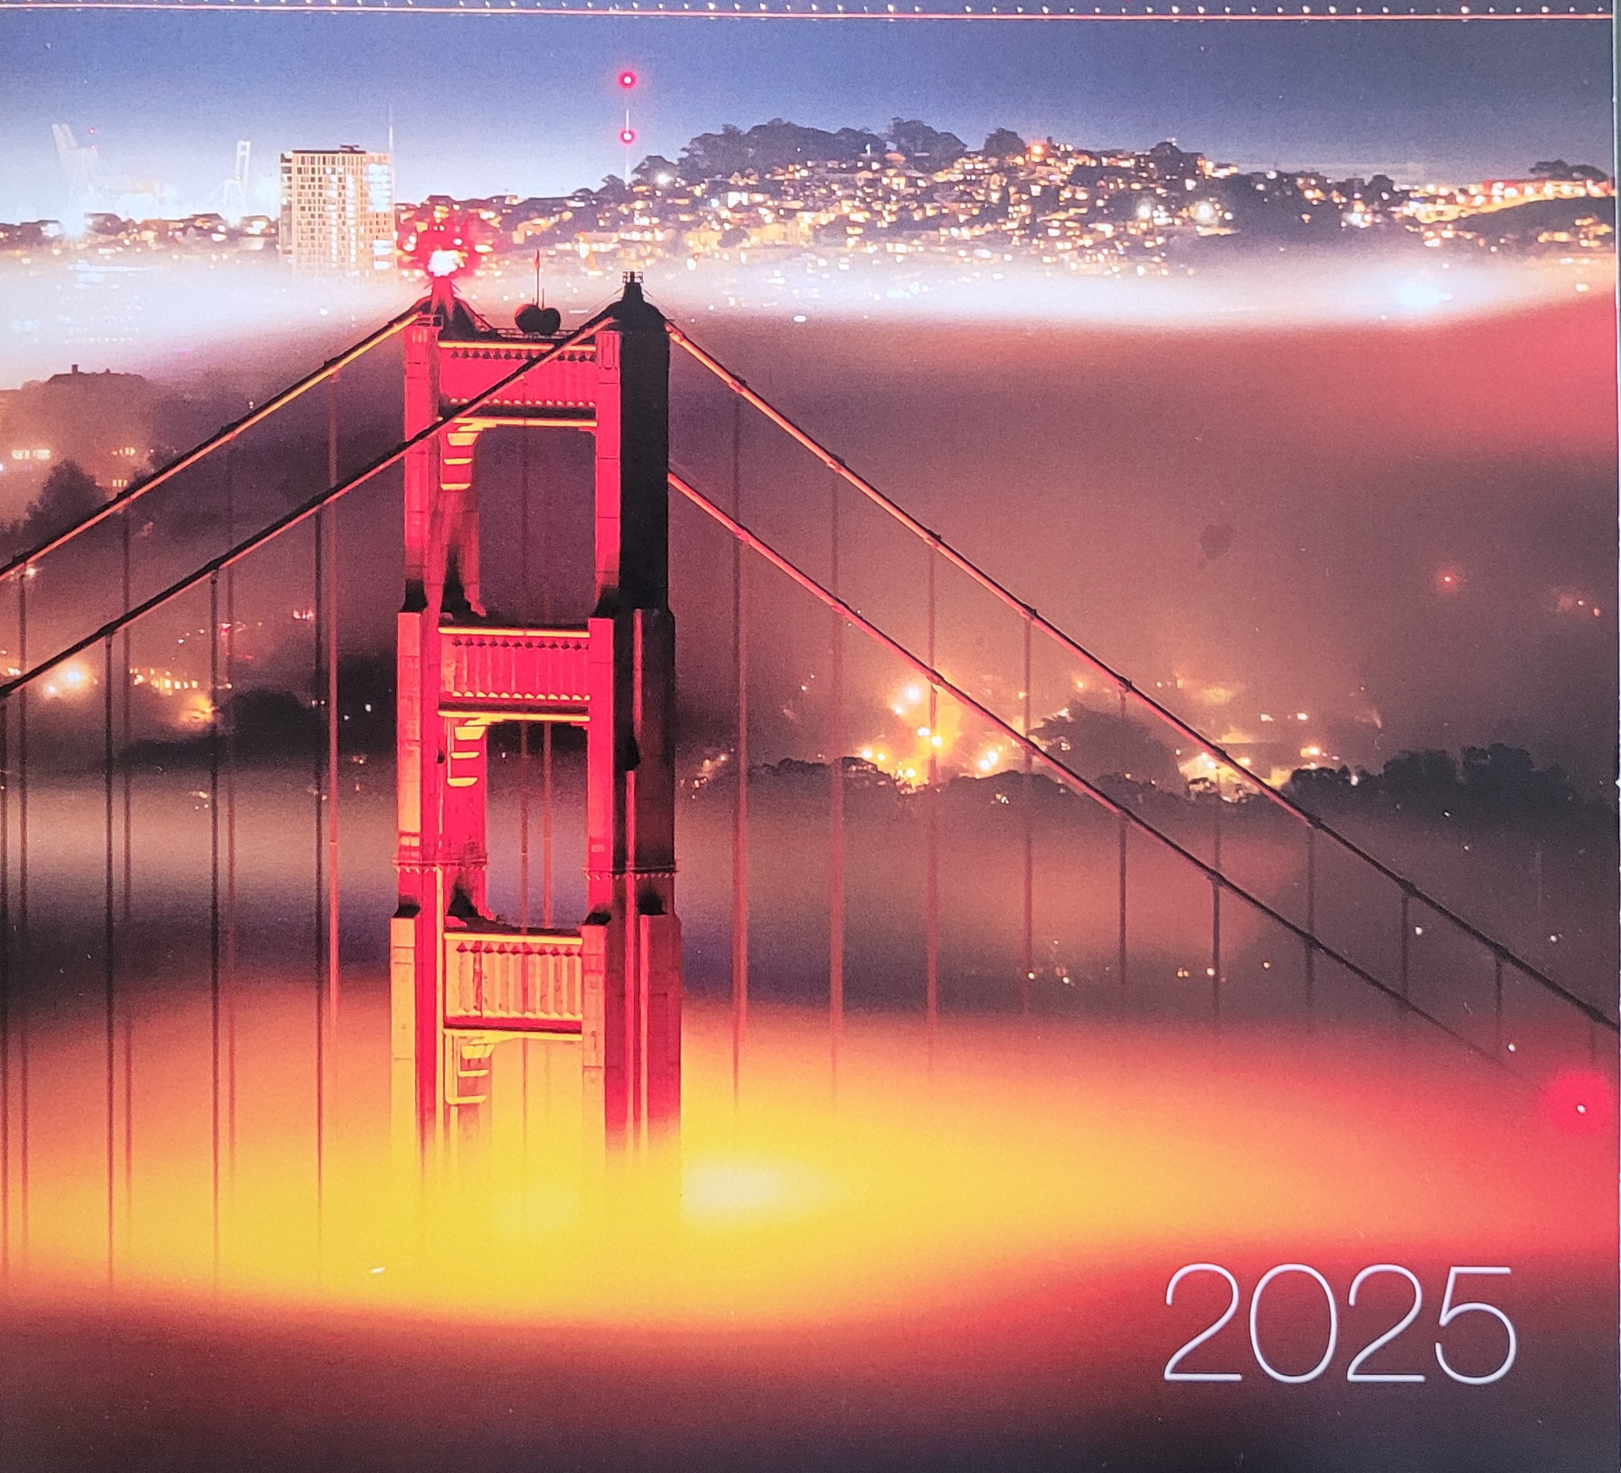
Highlights from the SFWC
Teri lOwn
Notes:
Good afternoon. I’m Teri Lown, a member of this club. I recently attended my first San Francisco writers conference in February. It was a great experience and I learned a lot. Because I’m new to writing this was a crash course in some valuable insider information, Kim asked me to share some of the highlights with you while we get ready for our featured speaker Peter Mountford. Let me tell you about the conference from the perspective of a newbie.

Slide 2
Embarcadero Waterfront
Notes:
The Embarcadero waterfront is a great spot to host a conference. There’s a lot to do and see here. Not as touristy as the Pier 39 Fishermans Wharf area, it still has stunning views of the Bay. It’s where the non-stop ferries dock and shuttle communters across the Bay. The Ferry Building is full of shops and little eateries just a short walk from the host hotel. Because Embarcadero is in the financial district, the weekends bring a different energy to the area. Some eateries are closed on the weekend.

Slide 3
Hyatt Regency Embarcadero
Notes:
The host hotel was beautiful. The SF writers club worked very hard on setting up the conference over the last year. All the details were in place and the guests had arrived, rooms were filling up. The first plenary session had started when we got news of a temporary power outage. Within minutes the lights were out and we were on emergency generator power. Apparently there was a small kitchen fire that turned off the power.
But that stunning sculpture in the atrium of the hotel was also a fountain. When the power went off for the kitchen fire the pumps for the outflow of the fountains base also went off. The entire atrium floor became flooded.

Slide 4
By a Glow Stick
Notes:
The flood in the atrium created a mess in the power center for the hotel. Half of the hotel was without power for the first two days of the conference. The rooms in the unpowered section were freezing cold, since we had a rainy start to our weekend. There was no hot water, so cold showers for these poor souls. And the kitchen went out. It was a disaster! Luckily the conference rooms were functional but some of the sessions were by these glowsticks that were everywhere. They finally got a big semi to come in that generated power until the damaged equipment had dried out. A real disaster but it worked out. Especially for me because I stayed in a hotel a couple blocks away, thank God.
Kudos to Lissa Provost and her team for keeping the conference running!

Slide 5
SFWC Formats and Tracks
Writing for Hollywood Summit
Fiction Craft
Nonfiction
Kidlit
Self publishing
Fundamentals Workshops
Consultation and Pitch Appointments
Keynotes
Master Classes
Notes:
The information was overwhelming, but they organized the presentations into Tracks so you could stick to a theme depending on your area of interest. Themes like Hollywood Summit for screenwriters, Fiction, Non Fiction. Kid Lit, self-publishing and my favorite, the Fundamentals track. The sessions were tailored to the theme so you could better choose which to attend. The Consultation and Pitch Appointments ran simultaneously to the sessions. They charged extra for these appointments, but the registration included one free pitch session with the person of your choice. That was brilliant because it gave me the motivation to try one. Consultations were one-on-one sessions with professionals like agents, editors and publishers. You could look them up by their bio in the program, but also got to know many of them through the various presentations. It gave me a flavor for the industry that is very complex.
We had two keynotes, Tommy Orange, author of NYT bestseller There There about his multigenerational family of urban Native Americans. The other keynote was Ilse McElroy, author of The Atmospherians and People Collide.
Master Classes were extra three hour sessions that you paid extra for and were outside of the main conference schedule.

Slide 6
Meet the Agents and Acquiring Editors
Notes:
The most valuable experience for me was the opportunity to better understand the publishing industry. We had a couple sessions where we got to hear from agents, acquiring editors, independent publishers, coaches, publicists, authors and screenwriters. In doing a pitch you had only 8 minutes to sell your story, being sure to leave about 4 minutes for feedback. I signed up for two pitches and had to good luck to sit next to an acquiring editor at the luncheon who was gracious enough to let me pitch her for free. She was my first one. I messed it up but her feedback was great. By my last pitch it was way better! It took the fear out of the equation.

Slide 7
How to Write a Book Proposal
Overview-enticement/excitement
Less than 5 pages
Clear sense of what the book is about
Central Idea
Market Relevance/ Comp Titles
Author’s Expertise
Marketing Plan
Timetable
Chapter Outline/Samples Pages
Andy Ross
Gordon Warnock
Jen Newens
Joey Garcia
Notes:
This session “How to Write a Book Proposal” was a panel discussion with these industry professionals Andy Ross, Gordon Warnock, Jen Newens and Joey Garcia. The takeaways for me are simplified by this slide. This is the detailed document you would send to a publisher to convince them your book idea is viable and worth investing in. Differs from a query letter in its detail and length. You need a clear sense of hat the book is about and be able to generate some interest and excitement about your project. You should be able to articulate the central idea of the story. Then some market relevance and current comp titles to show potential audience. You include information about yourself that is relevant to selling this book. Talk about publications, awards, expertise in the topic. Marketing plan is about your platform, your reach. Do you have online presence, a following? It’s also about showing how much time and energy you are willing to invest for your project. Timetable refers to the smart goals you have set for completion and publishing of your manuscript. Include the chapter outline and some sample pages from the beginning of the book.

Slide 8
Legal Issues for Writers
Publishing is about working with others and should be governed by written legal agreements
Business model of publishing will have unique issues to be considered
Literary Agents should be covered with an agreement
Mainstream publishers are complex
Self Publishing Agreements
Robert G. Pimm
Literary Law
Law Offices
San Francisco, CA
bob@rgpimm.com
Notes:
Legal issues for Writers was an eye-opener. Robert Pimm is a literary lawyer from the Bay Area. His talk showed all the complicated issues with regards to publishing. Because publishing is about working with others it should be governed by written legal agreements, to protect all the involved parties. Because publishing is so complex the business model will have unique issues to be considered, such as traditional publishing, self-publishing, hyrbids. He advised making sure you have a legal agreement when you are working with an agent, or any third party who may have future interest in the licensing. He discussed that traditional publishers will send you a sub-par contract unless you negotiate for your best interests. He told a story about a former supreme court justice who’d written a book. The traditional publisher sent over a contract for him to sign, which he dutifully did and returned in short order. The publisher was horrified that the crummy contract was actually signed by such an esteemed arbiter of the law that they promptly revised it for a fairer set of conditions. Self-publishing has its own myriad issues, so author beware. My main takeaway was that I will hire a literary law attorney when I get to the contract level.

Slide 9
First Draft Pitch
Entice the Agent to want to read more
The Hook, the Book, the Cook
Bring energy for your writing
8 minutes, 4 minutes or less of talking
2 sentences about the core of the story
Build energy and tension, CWC, published works
Be genuine, they are sizing you up
Notes:
This was a panel discussion with Gordon Warnock, Vicki Weber and Andy Ross about the all important first draft pitch. It’s important to have a first draft written so there is evidence of a completed book. Meeting an agent or publisher face-to-face for a quick 8 minutes, 4 of which is listening to feedback, is a great way to make a physical and emotional connection with a potential business partner. This photo is Michael Larsen, a longtime literary agent who help to co-found the SFWC. He was in an emeritus position, walking around with his red hat on meant he was open to conversation and giving advice.
His line, The Hook the Book and the Cook says it all, The hook is what gets your agent or publisher want to know more. The Book is a brief synopsis about the core of the story. You want to build energy and tension. The Cook is a brief statement about you as the author, like any published works and involvement in writers groups like the CWC. The pitch helps to prep the way for you to send a query letter if your project gets interest. I think its valuable to meet these pros, at conferences like the SFWC.

Slide 10
Query Basics
Process of seeking a Literary agent
Required if want to submit to publisher
Email is appropriate, one page, single space
Embed the query and synopsis together into the body of the email
Greeting, introduce self, metadata (word count, genre,POV, comp books should be current <2yrs)
Hook, one line pitch
Manuscript synopsis, book cover
Short Biography, publishing credential
Closing
Victoria Shi
Meredith Jaeger
Notes:
This presentation covered the basics of writing a query letter. This is the process for seeking a literary agent for submission to a publisher and convince them your project will be interesting and profitable. . Email is an appropriate for this one –page, single-spaced document. Embed the query and synopsis together in the body of the email. Start by greeting the agent, introducing yourself. Include metadata like word count, genre, POV, current comp titles. Your hook is the one-line pitch that piques interest. You should include a brief synopsis of the book, and any cover art you may have chosen. Be sure to include information about you as the author, like a short relevant bio and any credentials.

Slide 11
Query Letter Resources
QueryTracker
Reedsy.com
Jane Friedman.com
PublishersMarketplace.com
MSWL : Manuscript Wish List (by agent)
Websites : Query Shark
Query your critique group partners
Notes:
These are some resources for more information about query letter writing. Query Tracker is a free site that collects data about user query and agent experiences while helping you organize your query activity. Jane Friedman.com is a site to help writers understand publishing, as well as full of articles related to writing. Publishers Marketplace is a site to research literary agents and find the best one for you. Manuscript wish list is a place for agents and editors to post what they wish they had in their inbox. Only agents and publishers post but writers can search the posts to find people who are compatible with their work. Query Shark is a public forum to post your query letter and get feedback. Or just use your critique partners to practice with.

Slide 12
Pub Quiz Breakfast Harvey’s Dinners Gotts Roadside Nightcaps and Network Gala in the Atrium
Poetry and Jazz
Gala Attire and Writers
Notes:
Some of the fun activites included a Pub quiz contest at breakfast Harvey’s dinners are a meetup opportunity for a casual dinner to get to know others at the conference. Gotts Roadside is a burger joint in the Ferry building that’s a regular feature of the conference to share a meal with other attendees. They had other social functions like Nightcaps and network and the Gala event is a giant cocktail party. Remember with writers Gala attire means whatever you have on.

Slide 13
Becoming a Writer Who Can Succeed as an Author Nina Amir
What is identity? A mechanism that impacts everything about you
Who do think you are?
Who do you want to be?
It evolves with your goals
Be someone who applies what they learn
Changing your identity changes your behavior
Whatever you think about yourself will be
Notes:
This motivational talk was very helpful to me. It was about living the identity you seek with the behaviors that get you to the goal. Completely simple concept. Writers write consistently, they develop the habits of writing discipline. They make time to develop a platform and make the effort to market themselves.

Slide 14
Learning to Embrace All Aspects of Authorship Amy Bernstein Brenda Knight Eva Medilek Nina Amir
Promote
Network
Market
Submit Query Letters
Handle Business
Meet Deadlines
Seek Feedback
Work with Editors
Notes:
This presentation followed the same theme of evolving your behaviors to fit the identity of writer/author. In addition to writing you must make the time to promote yourself and your work. Network with other authors. Market and develop a platform. All the actions authors do should be part of your planning.

Slide 15
Mindset: I Can Do This Agents Love My Work I Am a Writer and Successful Author
Additional Ways to Be an Author Now
Posture
Vibe
Voice
Attire
Appearance
Look for Feedback
Notes:
And more good advice from the panel…embrace it all with confident posture, the tone of your voice, your attire, seek feedback for your work…these help you to evolve into the identity of author.

Slide 16
You Must Have a Platform: Here’s How to Build It Joey Garcia
Notes:
Joey Garcia is a Sacramento resident and is a publicist and book coach. Her presentation on building a platform convinced me of this necessary aspect of being an author. Websites, social media, podcast, Blog, You Tube Create the buzz, you need organic movement. Polish your speaking skills. Offer something that relates to your book to your potential readers on your platform. Or hire a publicist like Joey for around $16,000 for a two year contract. Platforms take time and timing is everything. It takes about two years to build a good network.

Slide 17
Memoir in the Marketplace
Lisa Kastner
Brooke Warner
Vickie DeArmon
Notes:
This panel discussion focused on memoir , what it is and what’s selling. Memoir as a slice of life, not autobiography. Should have the elements of resilience and survival. Not a victim story. Transformational story. Memoir writes into the truth.

Slide 18
Write Without Retraumatizing Yourself Lisa Cooper Ellison
Scale of distress and tolerance
Trauma changes our worldview
Write in your window of tolerance, use techniques to activate your internal wisdom
Order her workbook
The more intense the writing the more time you need to rest in between
Notes:
This was a good session by Lisa Cooper Ellison who is a book coach that is trauma-informed. She developed a scale of distress and she has a workbook you can order that also details how to write without re-traumatizing yourself. Best writing is between 3-6. Too much distress needs space and time. She mentioned some techniques to stay in prefrontal lobe like meditation, morning pages, and writing in third person may help. Traumatic writing takes time and you need to rest. If your writing leaves you high on the emotional scale then get into therapy.

