Slide 1
Presentation is Everything
Cover Design and Formatting
by Karen Phillips / PhillipsCovers.com

Slide 2
Why hire a cover artist?
“I won’t bother with a book if the cover is not professionally done.”
—Phillips Covers client

Slide 3
Cover Design
The Process
What is important to know for both designer and author?
Cost
Will Artificial Intelligence (AI) be used?
Examples of other covers client likes
Contract

Slide 4
What makes a good cover?
Front Cover - Key Elements

Slide 5
What makes a good cover?
Front Cover - Key Elements
Type that is readable at thumbnail size
Genre is clear
Eye-catching
Not too busy
Mood and tone conveyed

Slide 6
Genre Matching
What is genre matching?
First fit in, then stand out

Slide 7
Genre Matching

Slide 8
Cover Design
Cozy Mystery

Slide 9
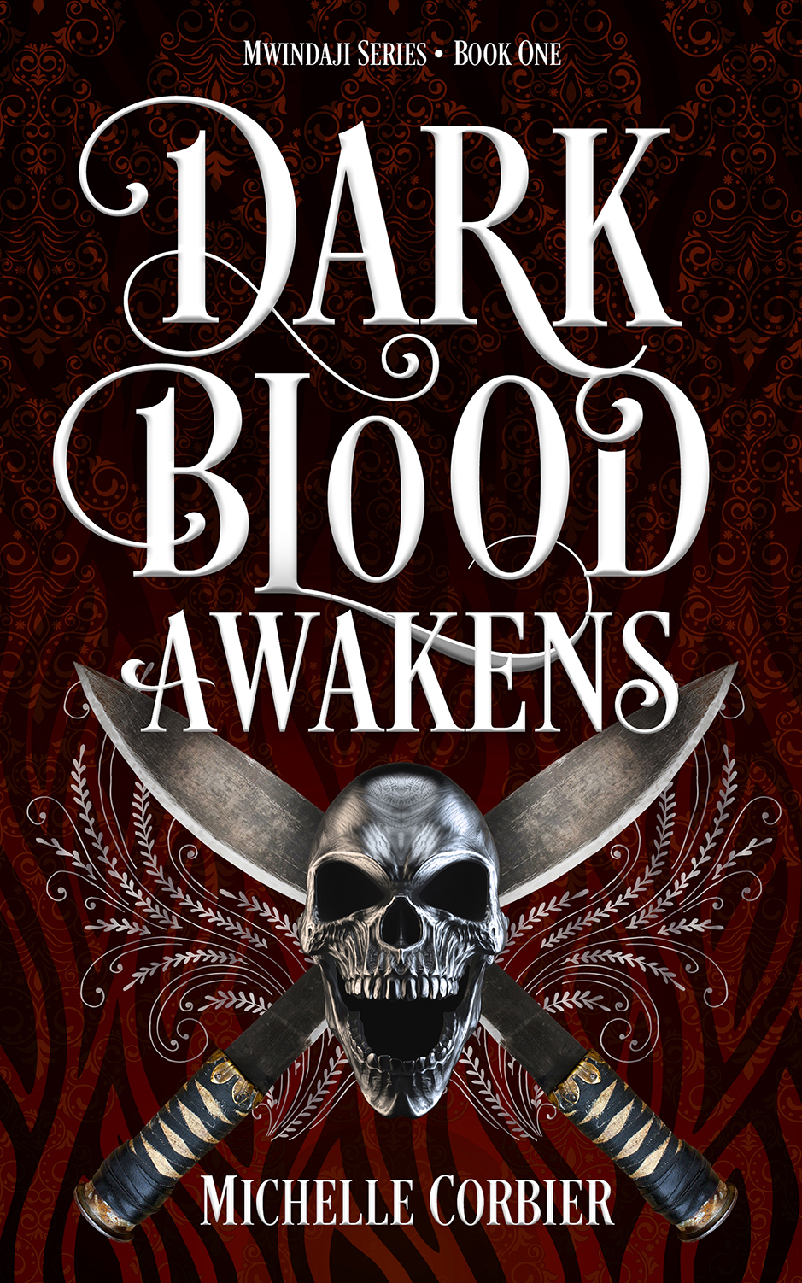
Cover Design
Misc Genres

Slide 10
Cover Design
Examples

Slide 11
Cover Design
Print Book (front cover, spine, back cover)
Matte cover finish is the traditional choice for fiction
Size of book is very important
A teaser grabs the reader, then a short blurb
Author bio (if not inside) - at the very least author website URL
Reviews or one good quote from a reader/reviewer
Other books
Imprint
The cover is the packaging for your book!

Slide 12
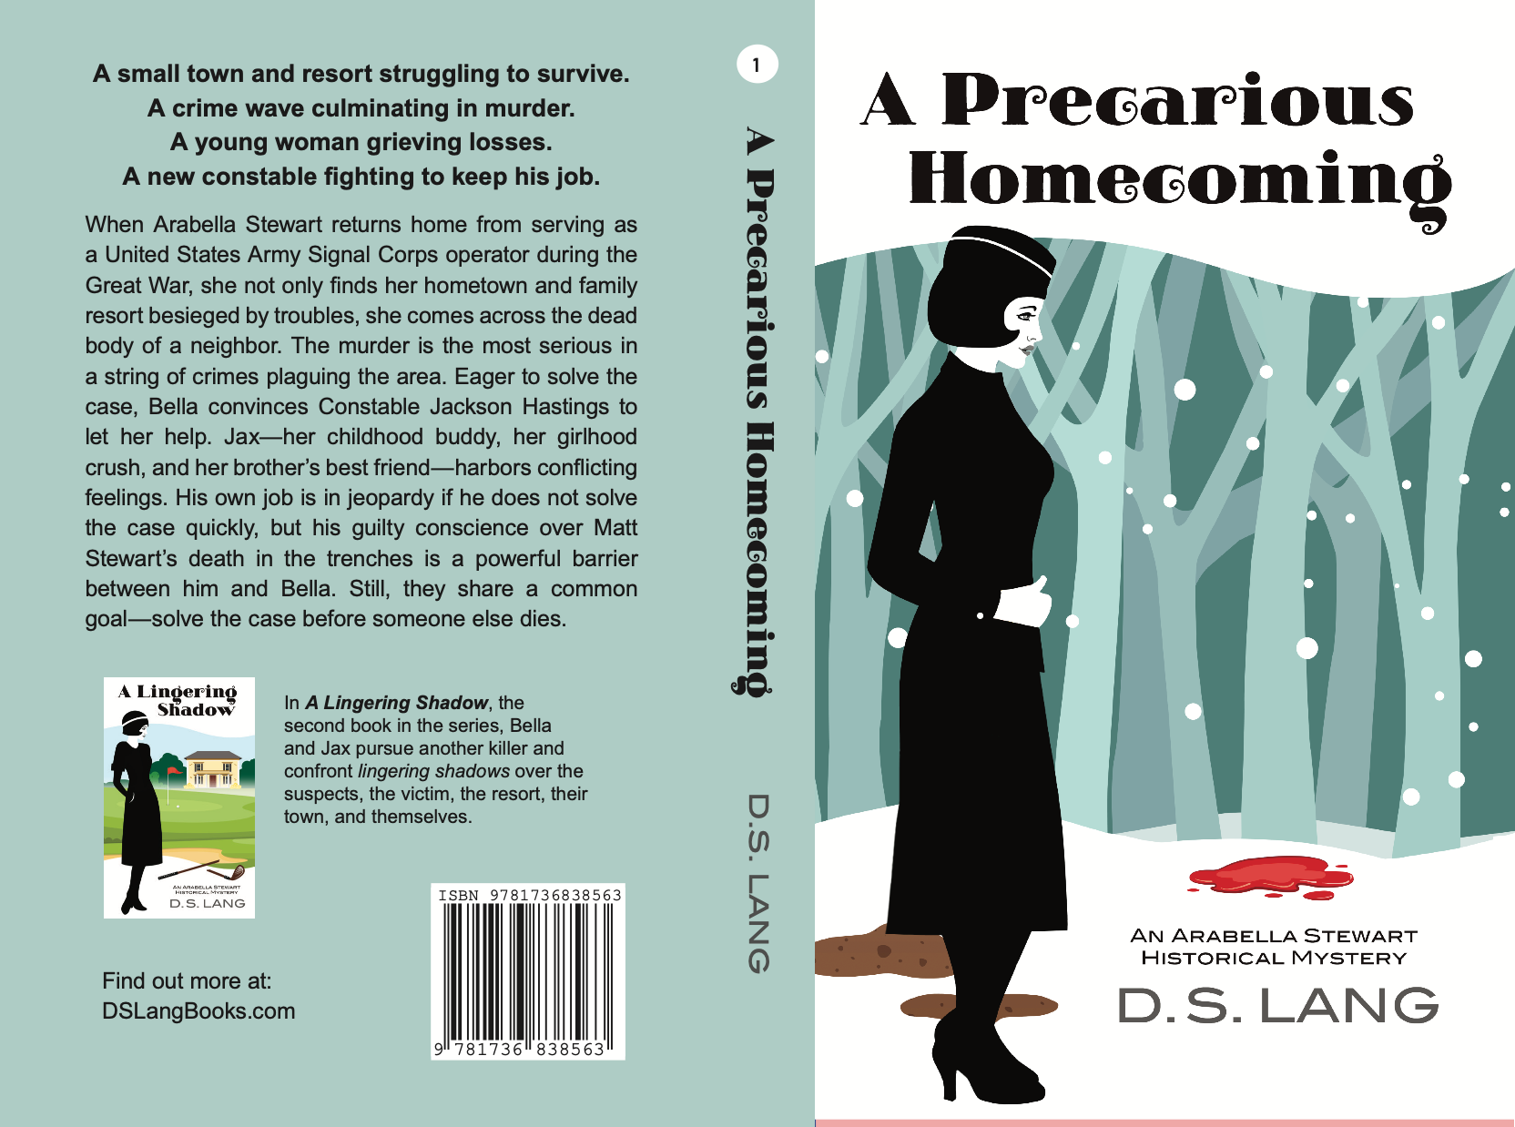
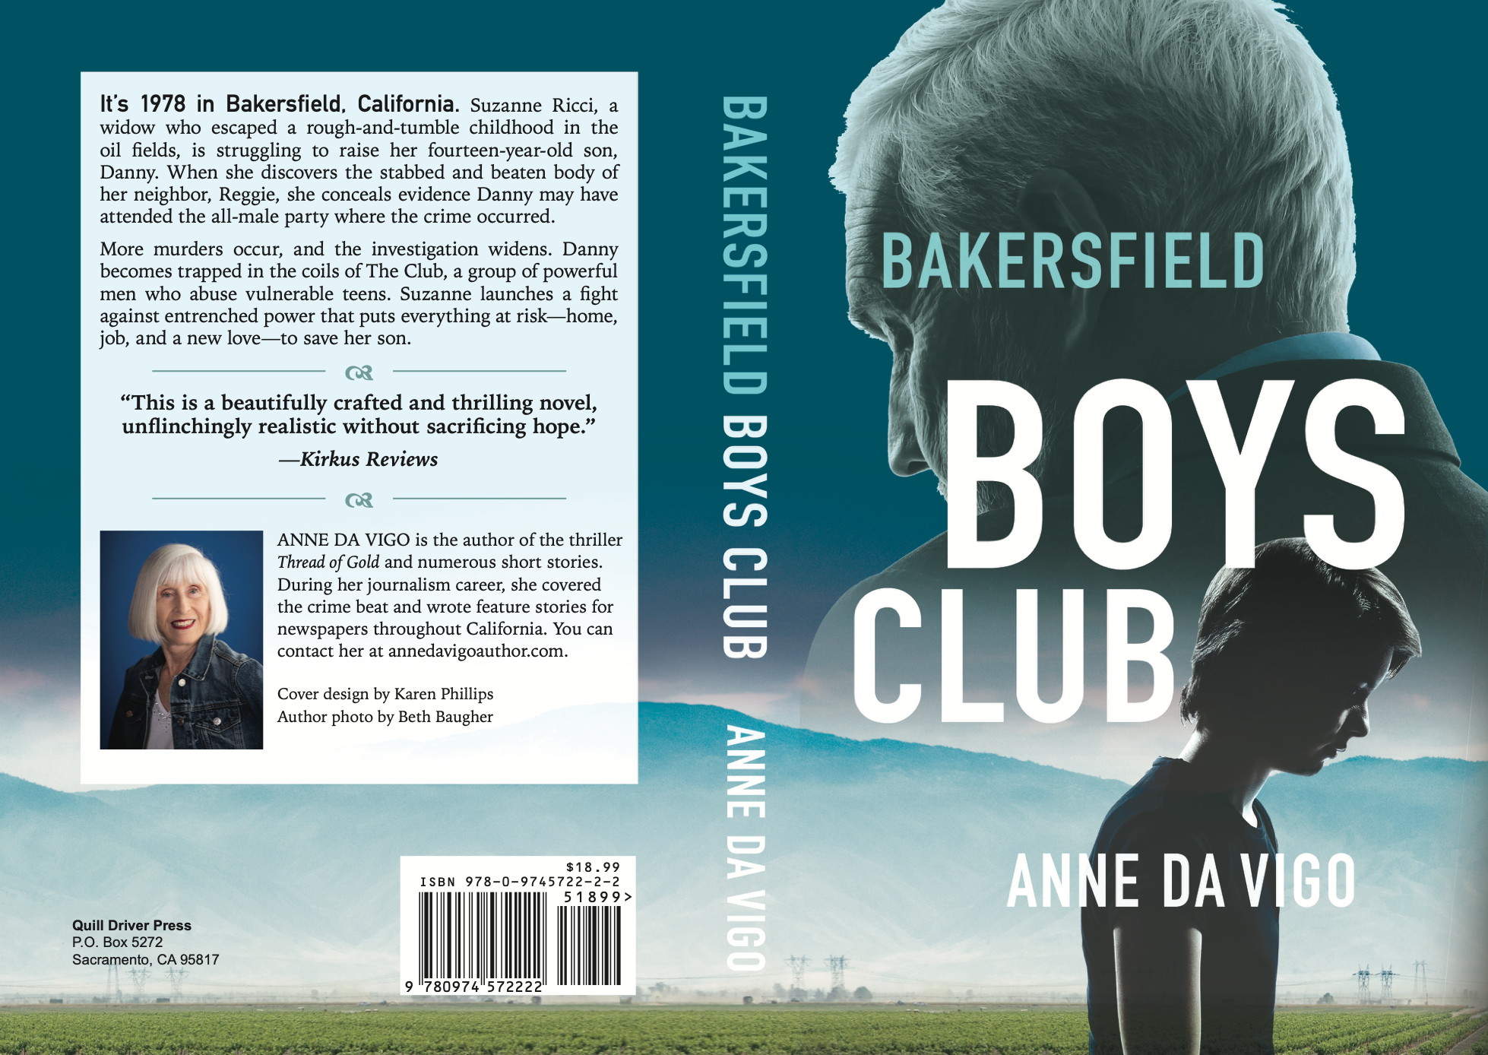
Cover Design
Examples

Slide 13
Case Study
Murder Is Revealing
by
Michelle Corbier

Slide 14
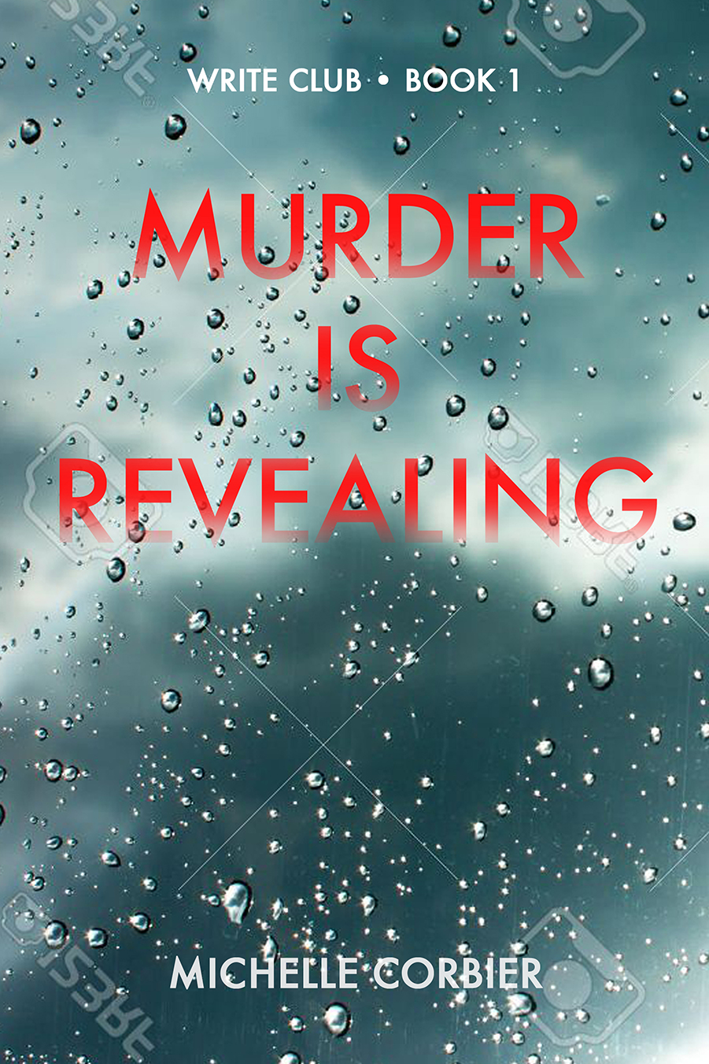
Case Study

Slide 16
Case Study Using AI
Under An English Heaven
by
Alice Boatwright

Slide 17
Case Study

Slide 19
Formatting
Key Elements
Professional
Easy to read
White space
Margins
Limit widows and orphans
Author bio at back with contact info and a request for honest reviews
Excerpt from next book (if series) or other book

Slide 20
Q & A
Thank you!
Karen Phillips
PhillipsCovers.com
info@PhillipsCovers.com
530-401-1541

