Slide 1
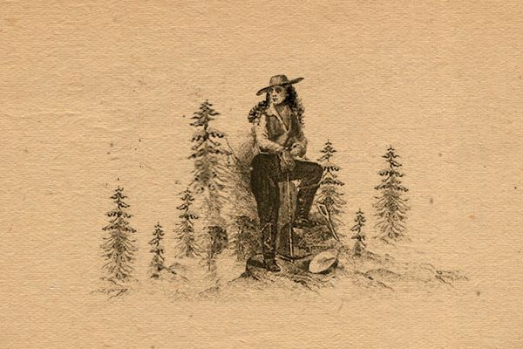
Madam Pantaloons
Gold Rush Pioneer

Slide 2
Life at Home
Jeanne Marie Suize was the seventh of twelve children, born in 1824 in the Duchy of Savoie
Only the eldest son could inherit, so Marie went to Paris in 1846 when she was 22.
There she fell on hard times and was rescued by a Parisian woman who got her a job at a newspaper.
When Napoleon III seized power in 1848, life got harder
No bread, no jobs, social unrest
In 1849, “Emperor Napoleon” urged people to go to America and look for gold
What would life be like in this new land?

Slide 3
Travel to California
Overland across prairies and mountains
By sea via Panama
By sea in other ways
Down the east coast of the United States and around the horn
From Europe and Africa to the horn and around
From Asia, Australia and Pacific Islands across the Pacific Ocean

Slide 4
Women’s Rights in the U.S. in 1849
Key things that women were not allowed to do or had limited ability to do:
Vote in elections
Own property (if married)
Access higher education
Work in certain professions
Serve on juries or Hold public office
Get a divorce without a husband’s consent
Control their own earnings (if married)
Access birth control or Control reproductive rights

Slide 5
Women’s Rights in 1849, cont’d
Sign legal contracts (if married)
Publicly speak or Participate in political life
Travel or Move frequently (if married)
Have legal rights over children (if married)
Use the legal system independently (if married)
Participate in labor movements

Slide 6
San Francisco
“Every man to himself, and the Devil to them all.”
Culture shock
Lack of social structure
Upside down value system
Many would-be argonauts just turned around and left.

Slide 7
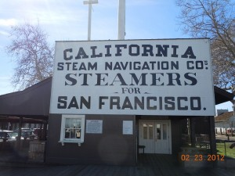
Travel to the Mines
Overland travelers could go straight to the mines
Those who arrived in San Francisco by ship had to travel east into the foothills where the mines lay
The very first steamboat to travel up the Sacramento River was the George Washington, in 1849.
Initially fares were up to $30, but competition (and a monopoly) drove the fare down to a dollar
From Sacramento, you could ride a stagecoach or a mule to the mines
It is not known whether Marie Suize went by mule or stagecoach from Sacramento to Jackson. There she found fellow Savoie men at a mining camp, one of whom was Andre Douet

Slide 8
Life in the Mining Camps
A reordering of the social structure
No women were present.
Those who had traveled overland had become accustomed to cooking, etc.
Sea travelers, not so much!
Camps were formed and duties assigned
Cooks rotated once a week, good or bad, no excuse
Men learned to bake bread, their main sustenance in addition to hunting and fishing
Meals were restricted to bread and meat until pickled vegetables could be obtained
Evenings were spent drying socks by the fire, smoking pipes and telling stories or re-reading letters
Summers were very hot, and winters were cold. Miners knocked off around 11 am in the summer and went back to work later in the afternoon. (And they had called the Panamanians lazy for doing the same thing!)
Tools: first simple panning, then sluices, and finally rockers, or long toms. Tunnels were dug and defended.

Slide 9
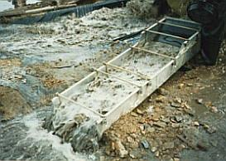
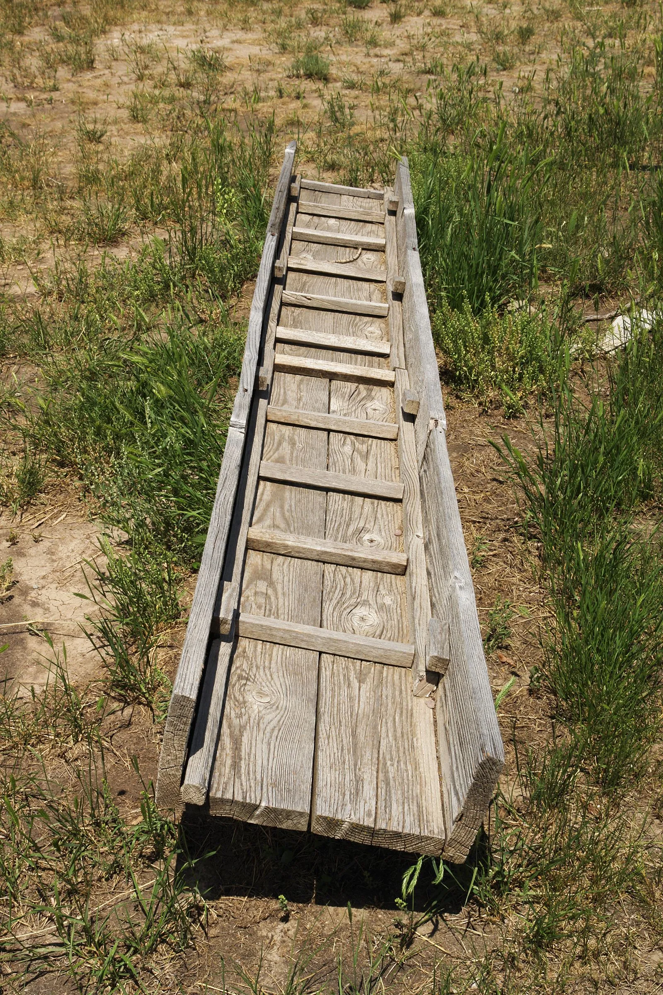
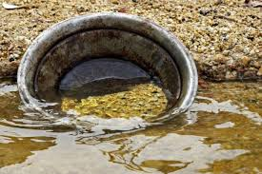
Mining Tools
Dams (and “dam jumping”)
Blasting with TNT
Tunnels
Hydraulic mining (1853)

Slide 10
Jeanne Marie Suize: An Accomplished Businesswoman
Entered into a business agreement “by handshake” with Andre Douet for a mining concession
Signed deeds to mines and defended them (earning the nickname Marie Pantalon)
Signed a petition for water supply work to be undertaken (only woman of 100 miners to sign)
Bought a ranch with Douet
Planted mulberry bushes and fruit trees and bred silkworms
Planted extensive vineyards

Slide 11
Secreta Gulch Ranch – “French Garden”
Mme. Maria Suize is the proprietress of an 800-acre tract of land, situated six miles east of Jackson, and is cultivating some 30,000 vines, and manufacturing about 12,000 gallons of wine and 000 gallons of brandy annually. With a view to silk raising she is cultivating 3,000 mulberry trees. At this writing there are on hand at this ranch some 18,000 gallons of wine, from one to five years old. It is kept in twenty-four 800-gallon casks, manufactured from a species of black live oak, cut, sawn and manufactured upon the farm. Two large 3,000-gallon casks are used for making the red wine. Five men are regularly employed.
Pacific Rural Press, Volume 1, Number 14, 8 April 1871

Slide 12
Advertisement (Virginia City store)
Suize opened wine shops in San Francisco and Virginia City, NV
She was arrested 3 times for wearing pants
She finally petitioned the authorities of Virginia City to allow her to wear pants

Slide 13
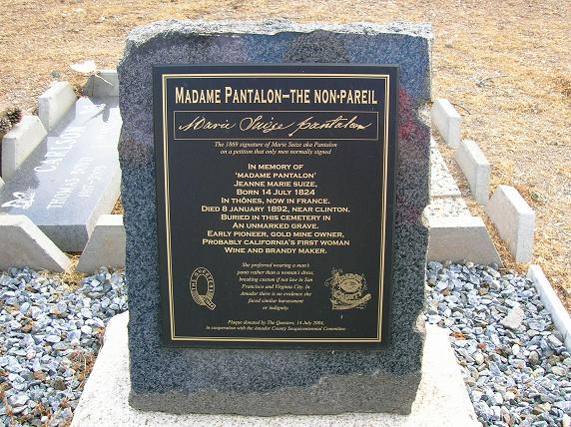
Later Years
Suize gambled on the Comstock Lode and lost all her money
She died penniless in 1892 and was buried anonymously at St. Patrick’s Cemetery in Jackson
For the 150th anniversary of Amador County, a tombstone was built for her at St. Patrick’s

Slide 14
Still Illegal for American Women Until???
Open a bank account or get a credit card without her father’s or husband’s signed permission
Serve on a jury
Obtain any form of birth control without her husband’s permission
Get an Ivy League education
Experience equality in the workplace
Keep her job if she is pregnant
Refuse to have sex with her husband
Get a divorce with some degree of ease
Have a legal abortion in most states
Take legal action against workplace sexual harassment
Play college sports
Apply for men’s jobs

