Slide 1
Crossing Genres
ML Hamilton

Slide 2
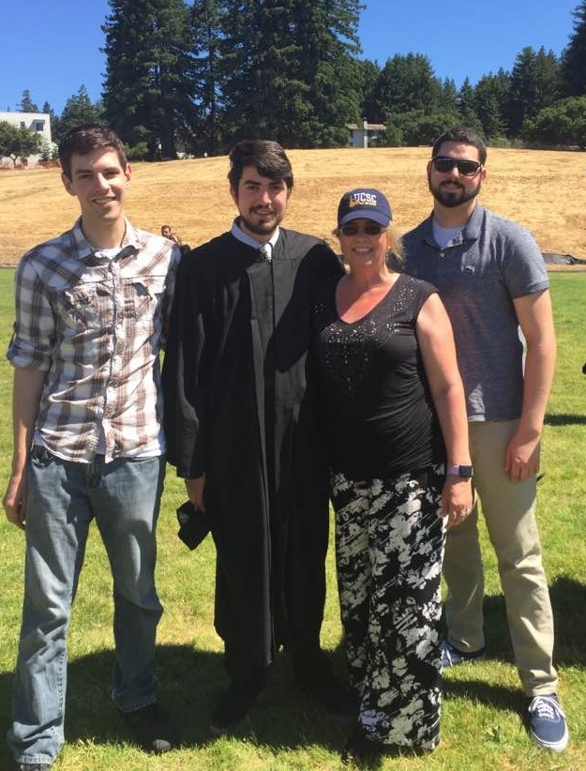
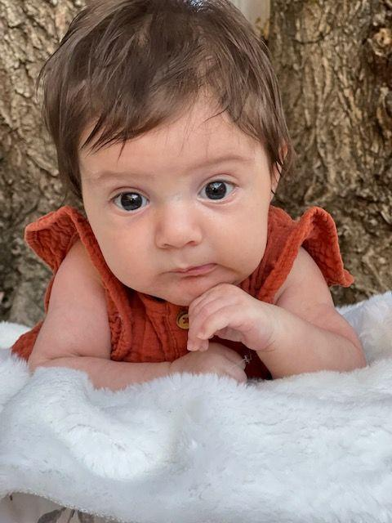
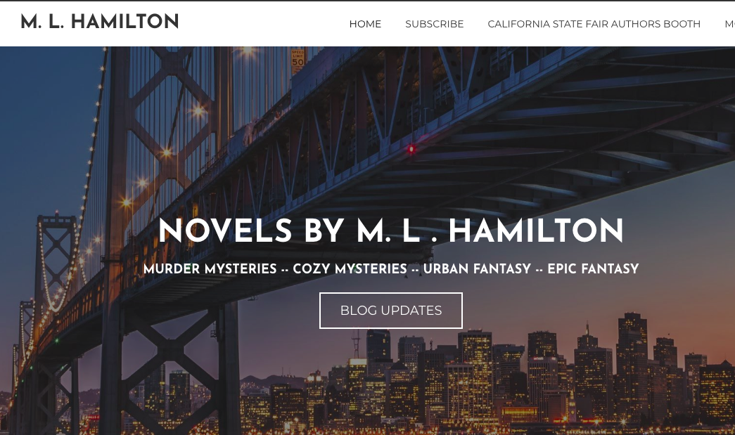
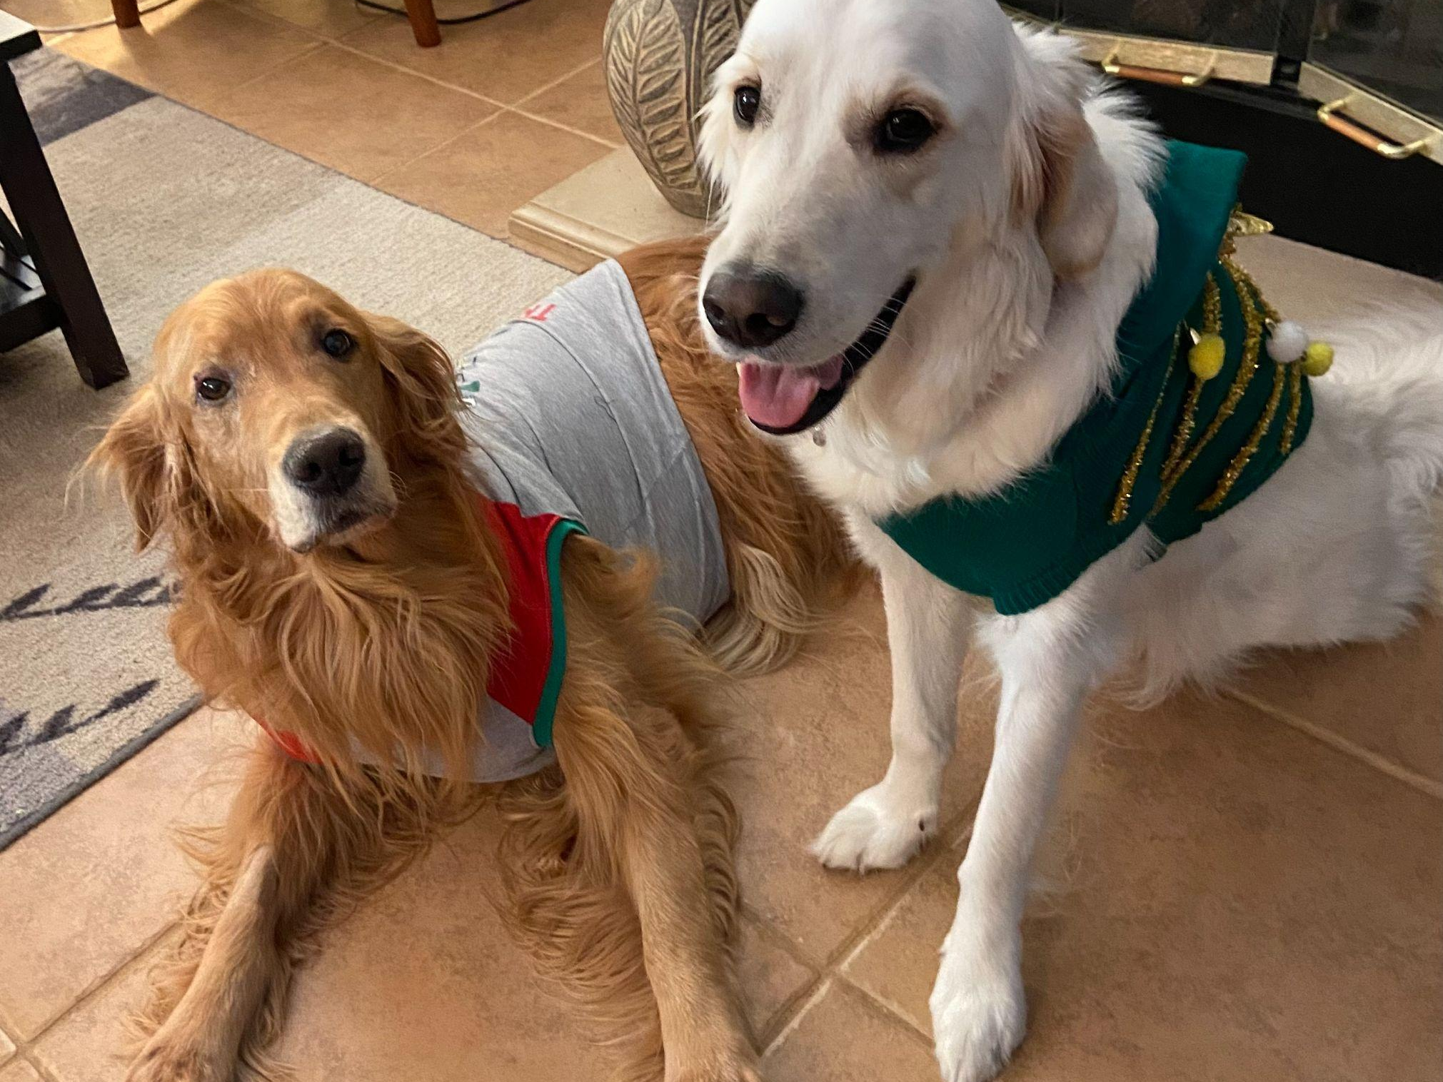
About me
Single mother of three sons/one daughter-in-law
Grandmother of Zoey
Pet parent to three dogs and one cat
High school English teacher of 29 years
Author of more than 65 books

Slide 3
About me
President of NCPA
Manager of California State Fair Authors Booth
Editor

Slide 4
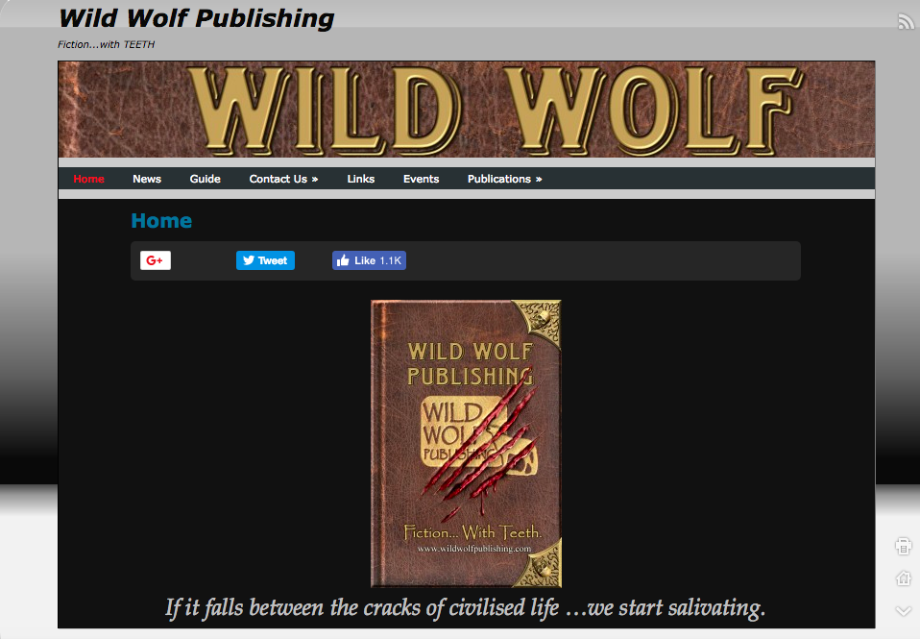
About me:
2010 First New Year’s Resolution
To get serious about my writing by either finding an agent or a publisher.
100’s of query letters
One (1) response

Slide 5
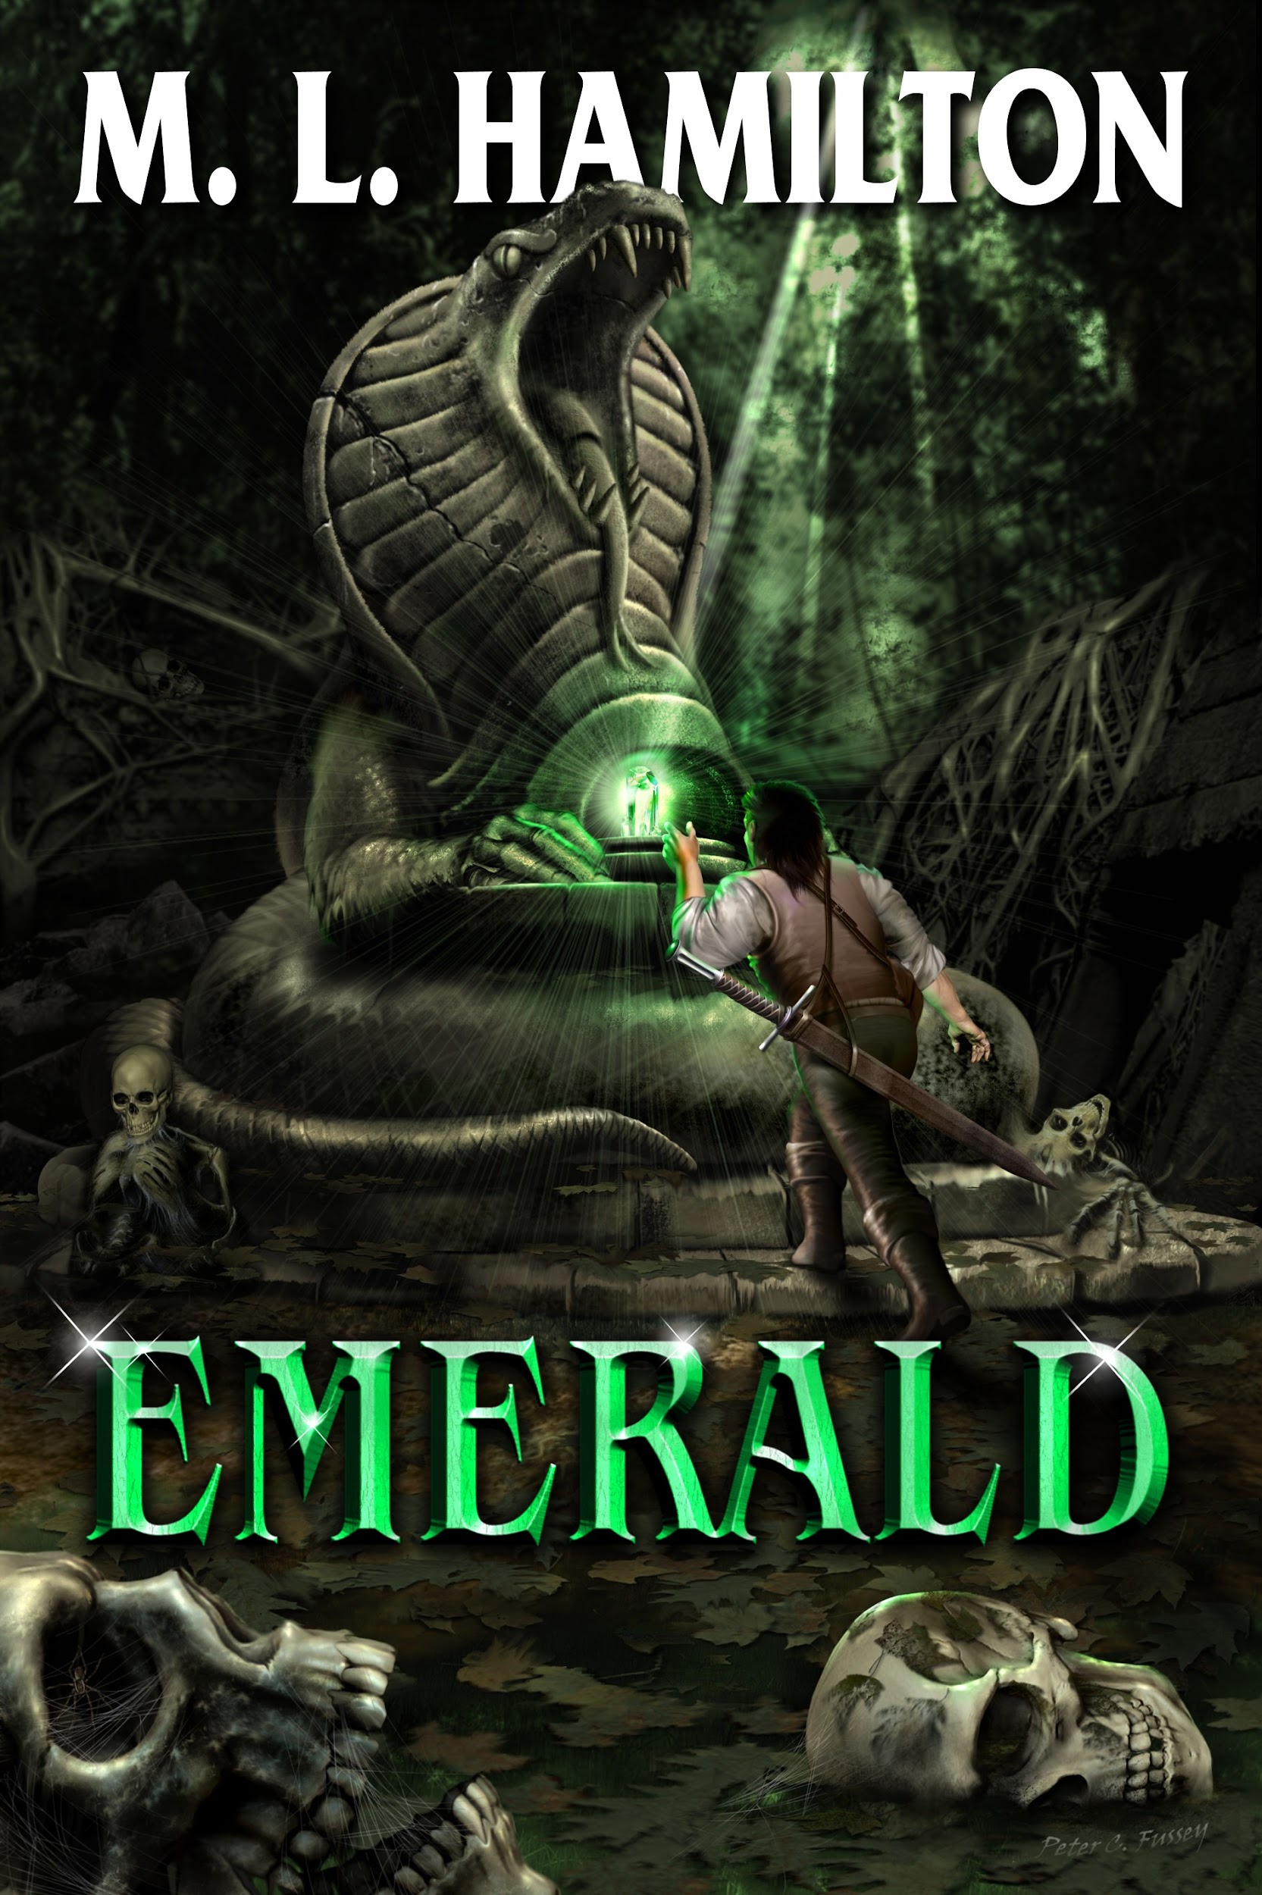
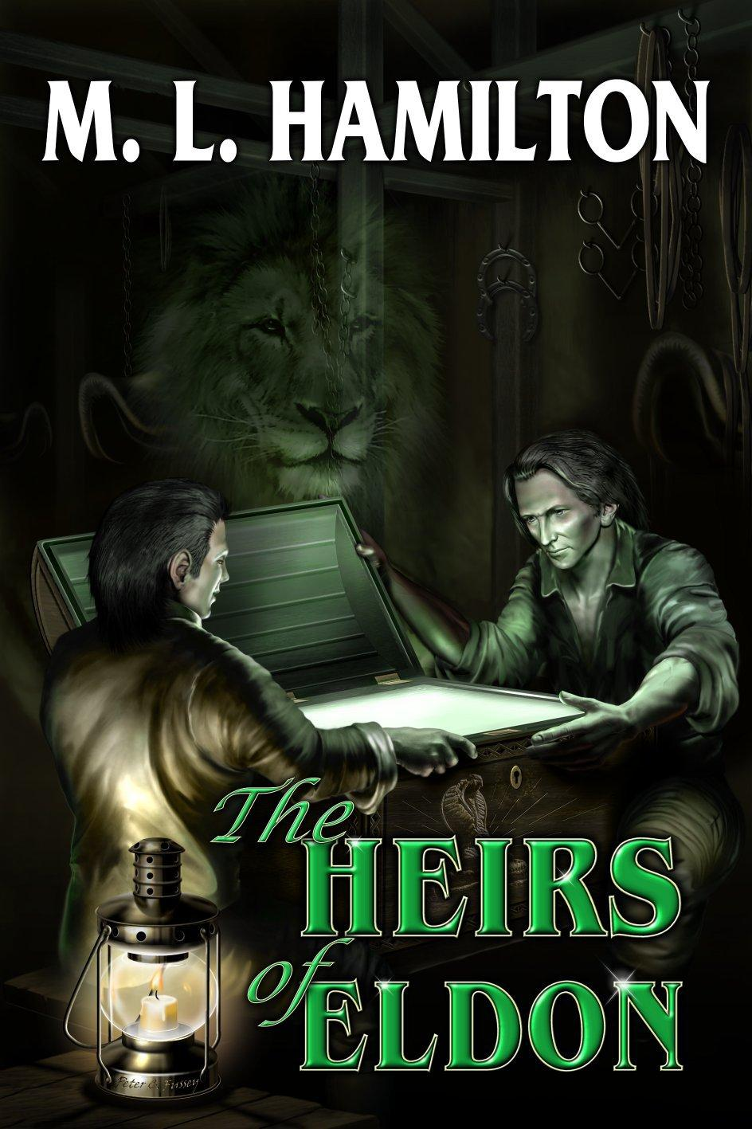
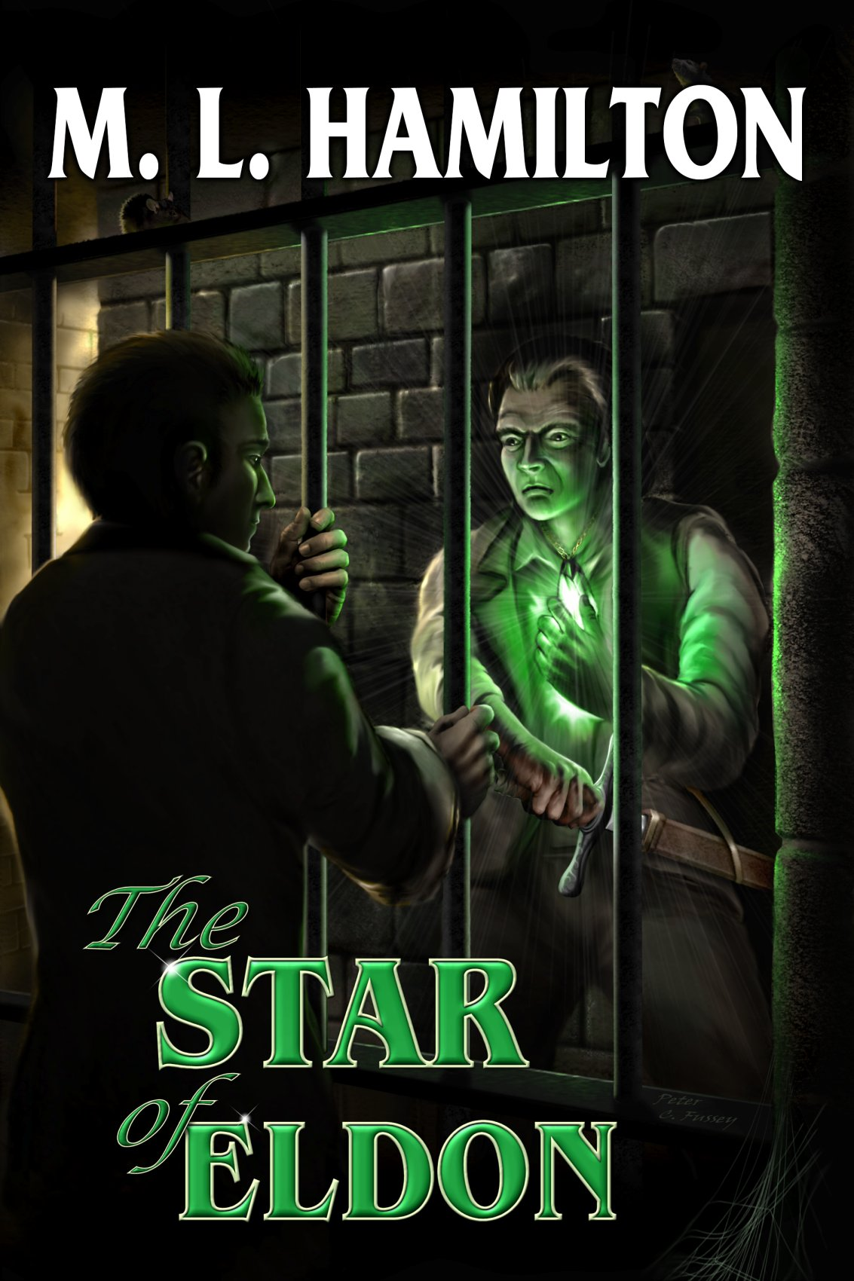
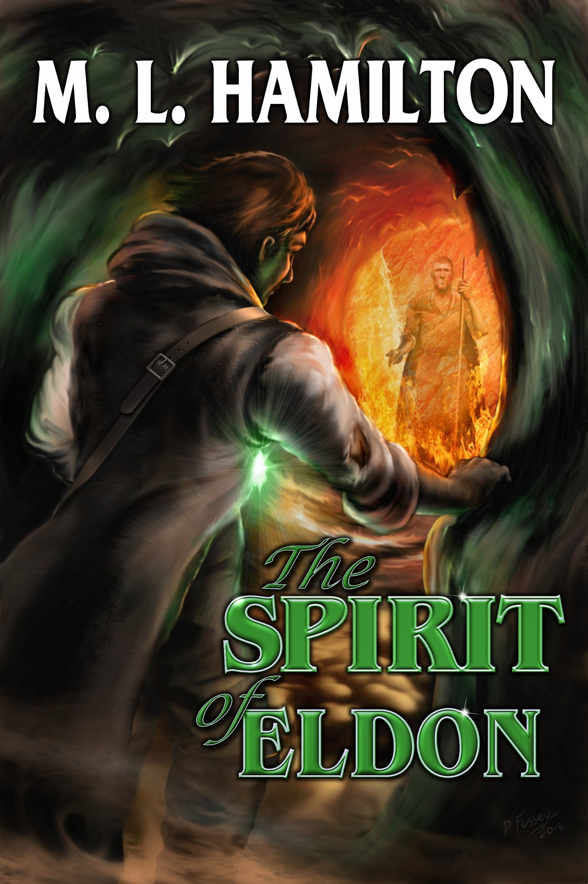
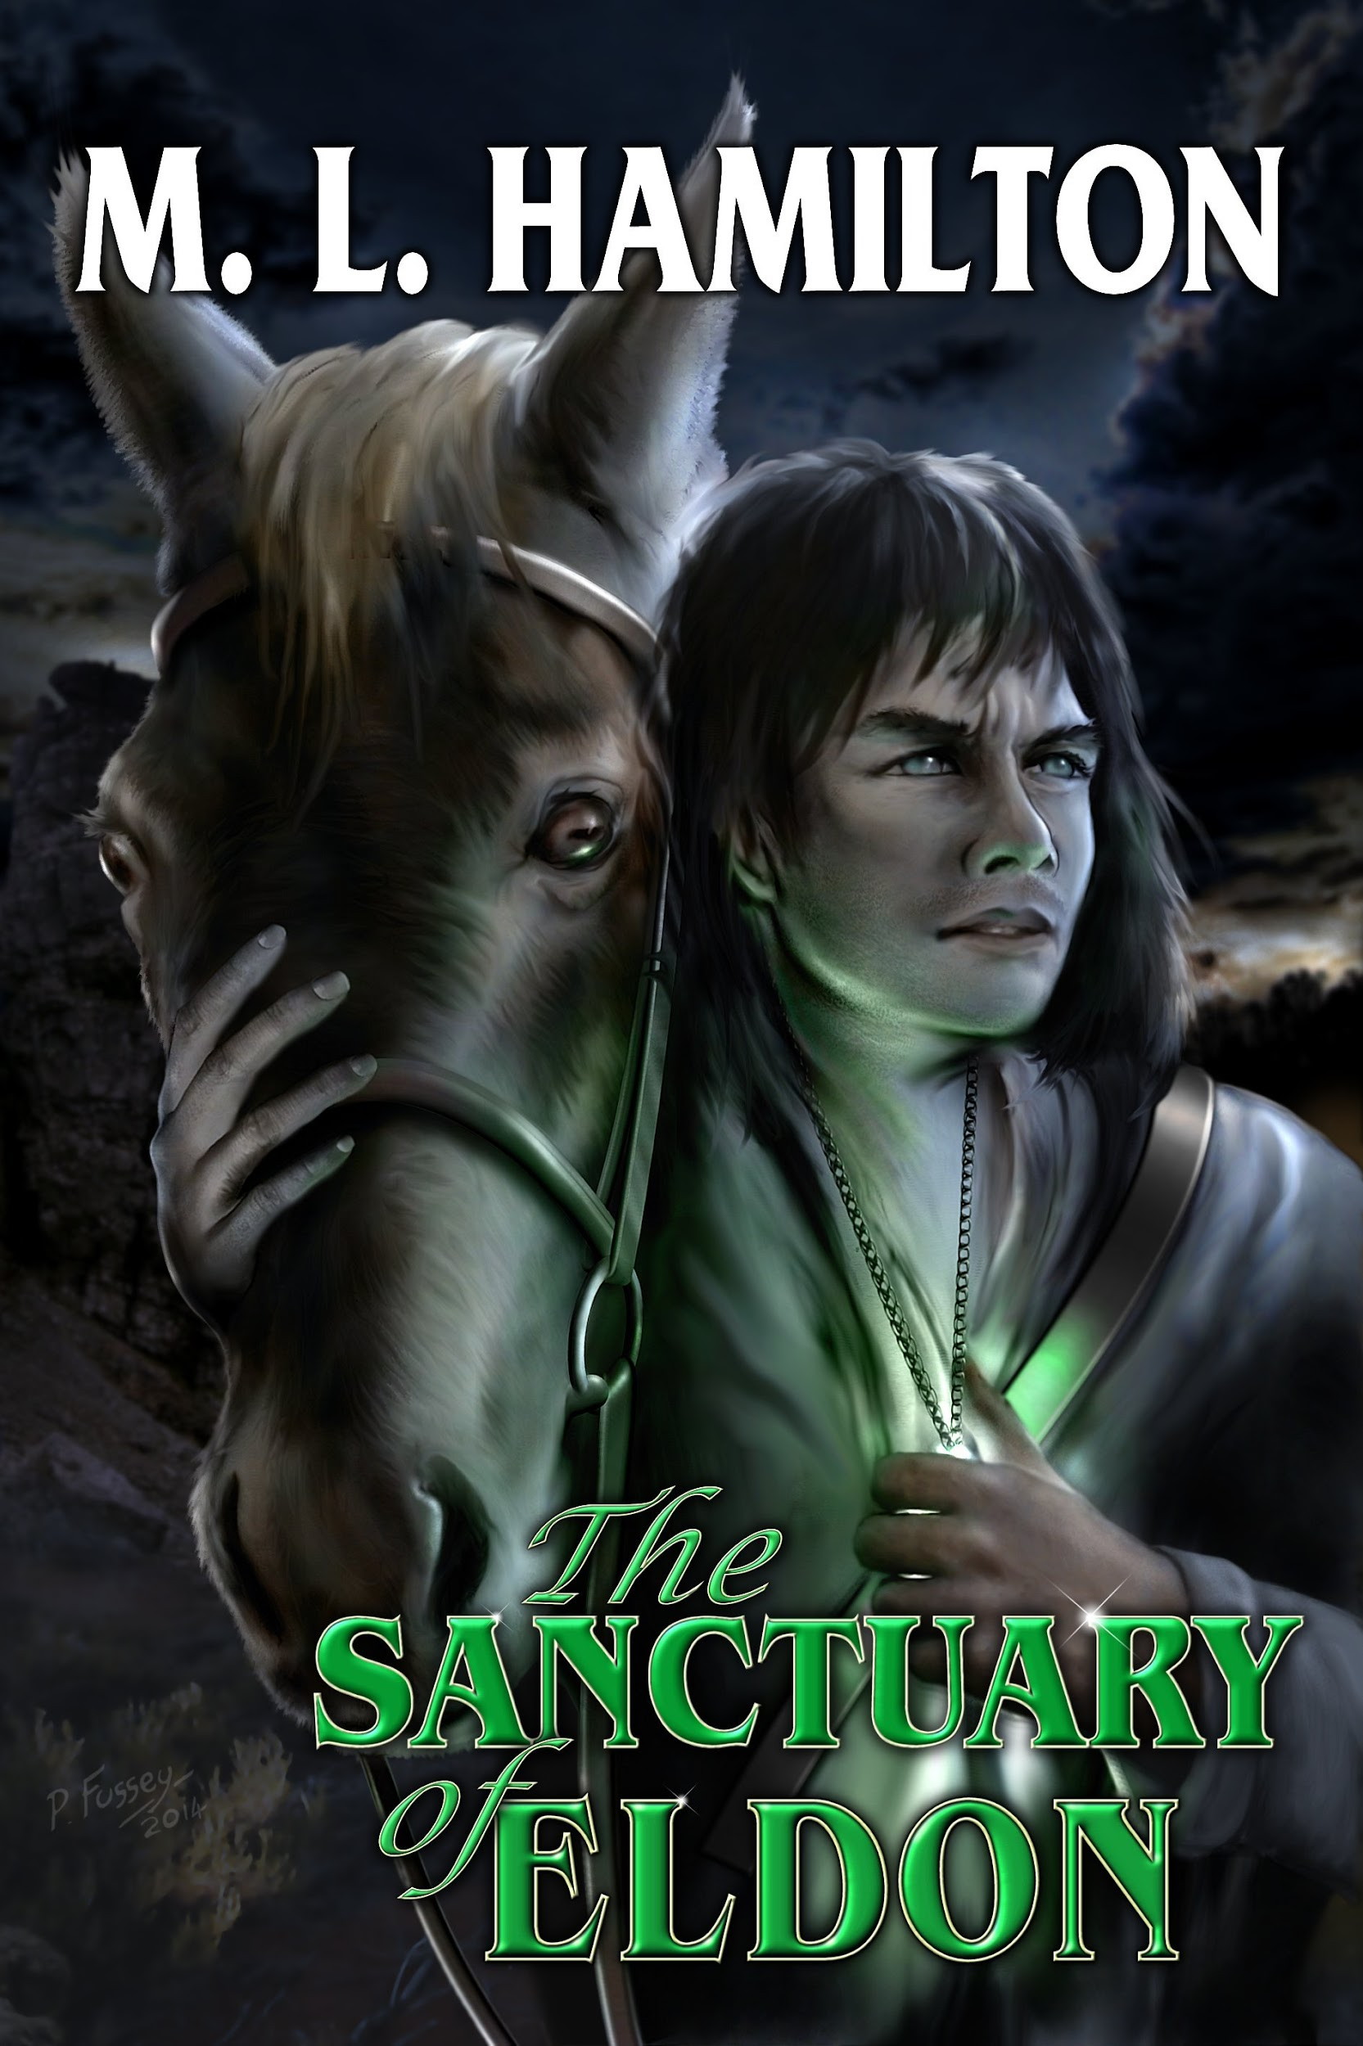
Epic Fantasies
Five years (5) and five (5) books with Wild Wolf
All epic fantasies
Built audience in England and US

Slide 6
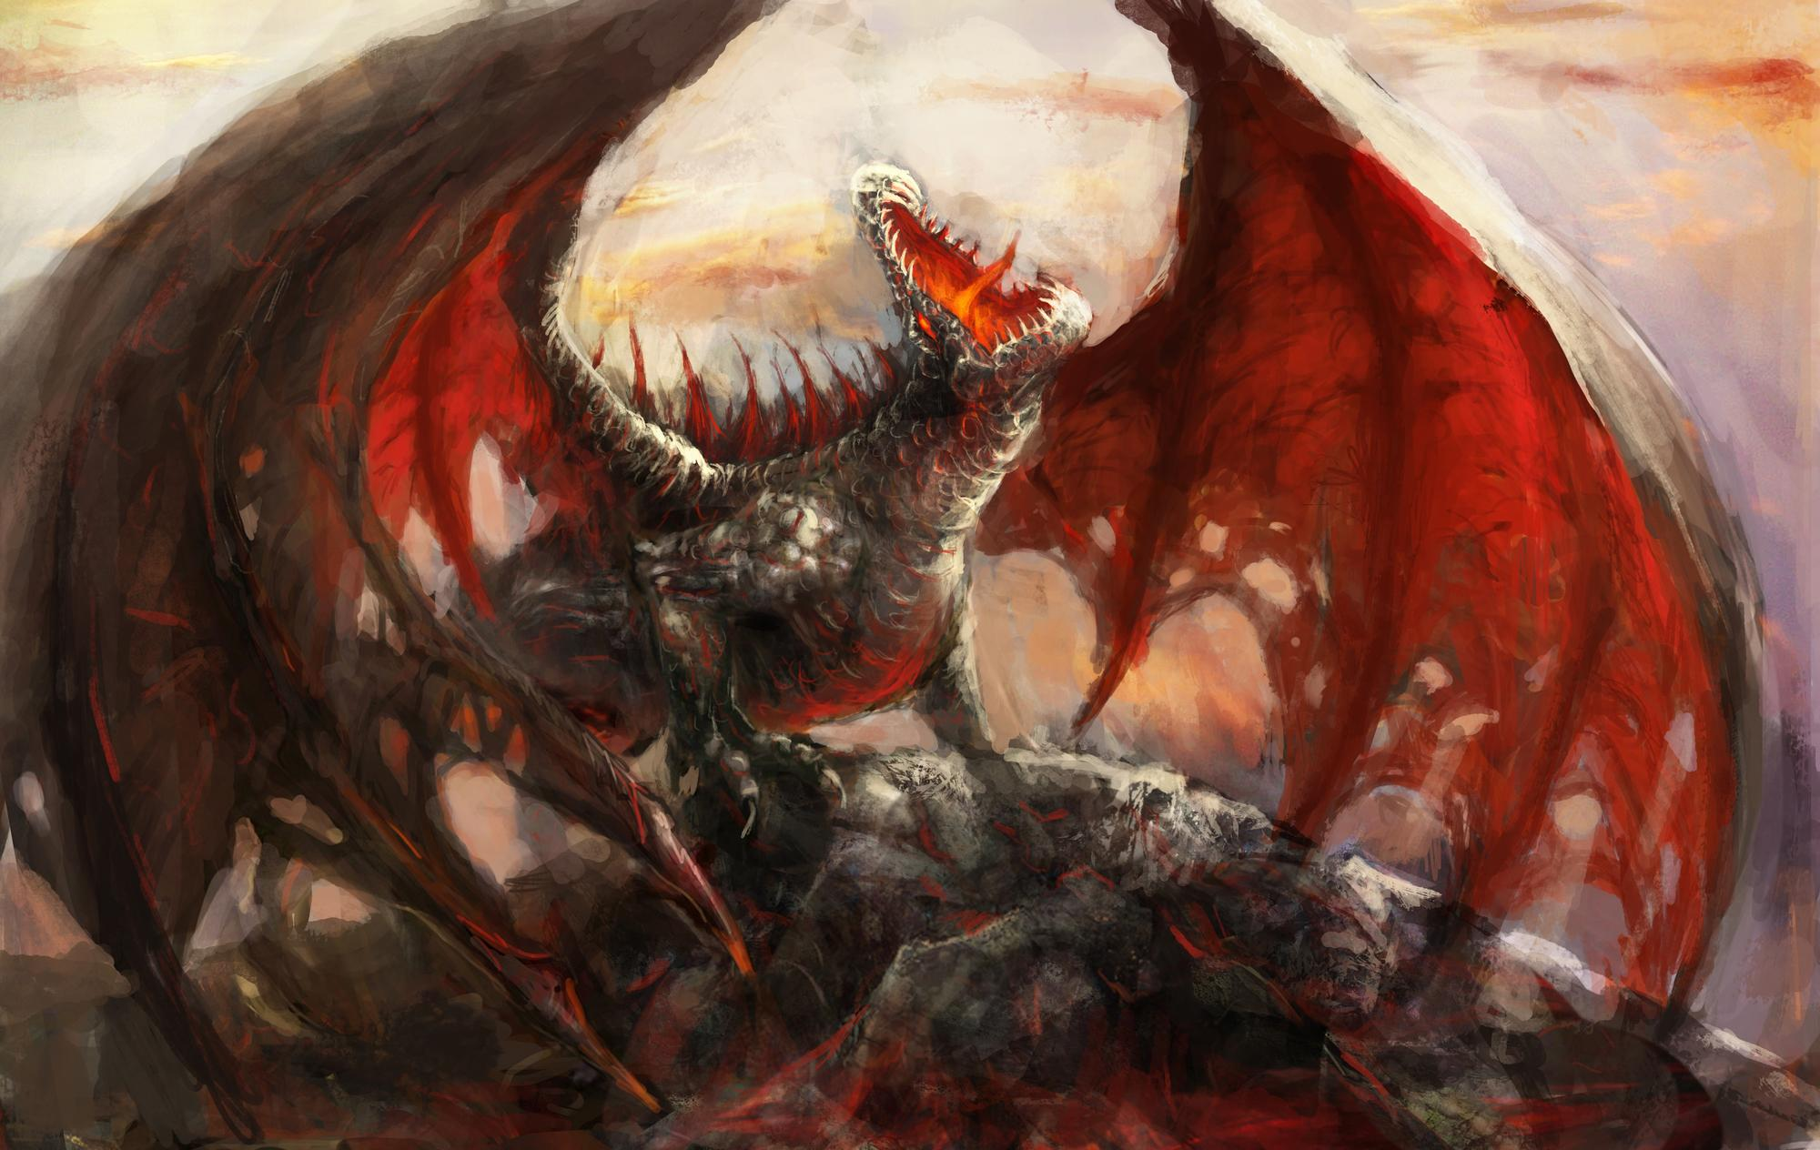
Characteristic of an Epic Fantasy
Large world building
Many characters
Multiple generations
Some sort of magical power source
A Hero’s Journey

Slide 7
Hero’s Journey In Brief
Resurrection
Call
Call to adventure
Refusal of the call
Meet the mentor
Ordeal (Adventure) and Reward
Road Back
Resurrection
Ordeal
Refusal
Mentor

Slide 8
Venturing Out
Decision to Self-Publish
5 years of instruction with a safety net
Built up an audience
Want to venture into different genres
One (dark) spark of inspiration

Slide 9
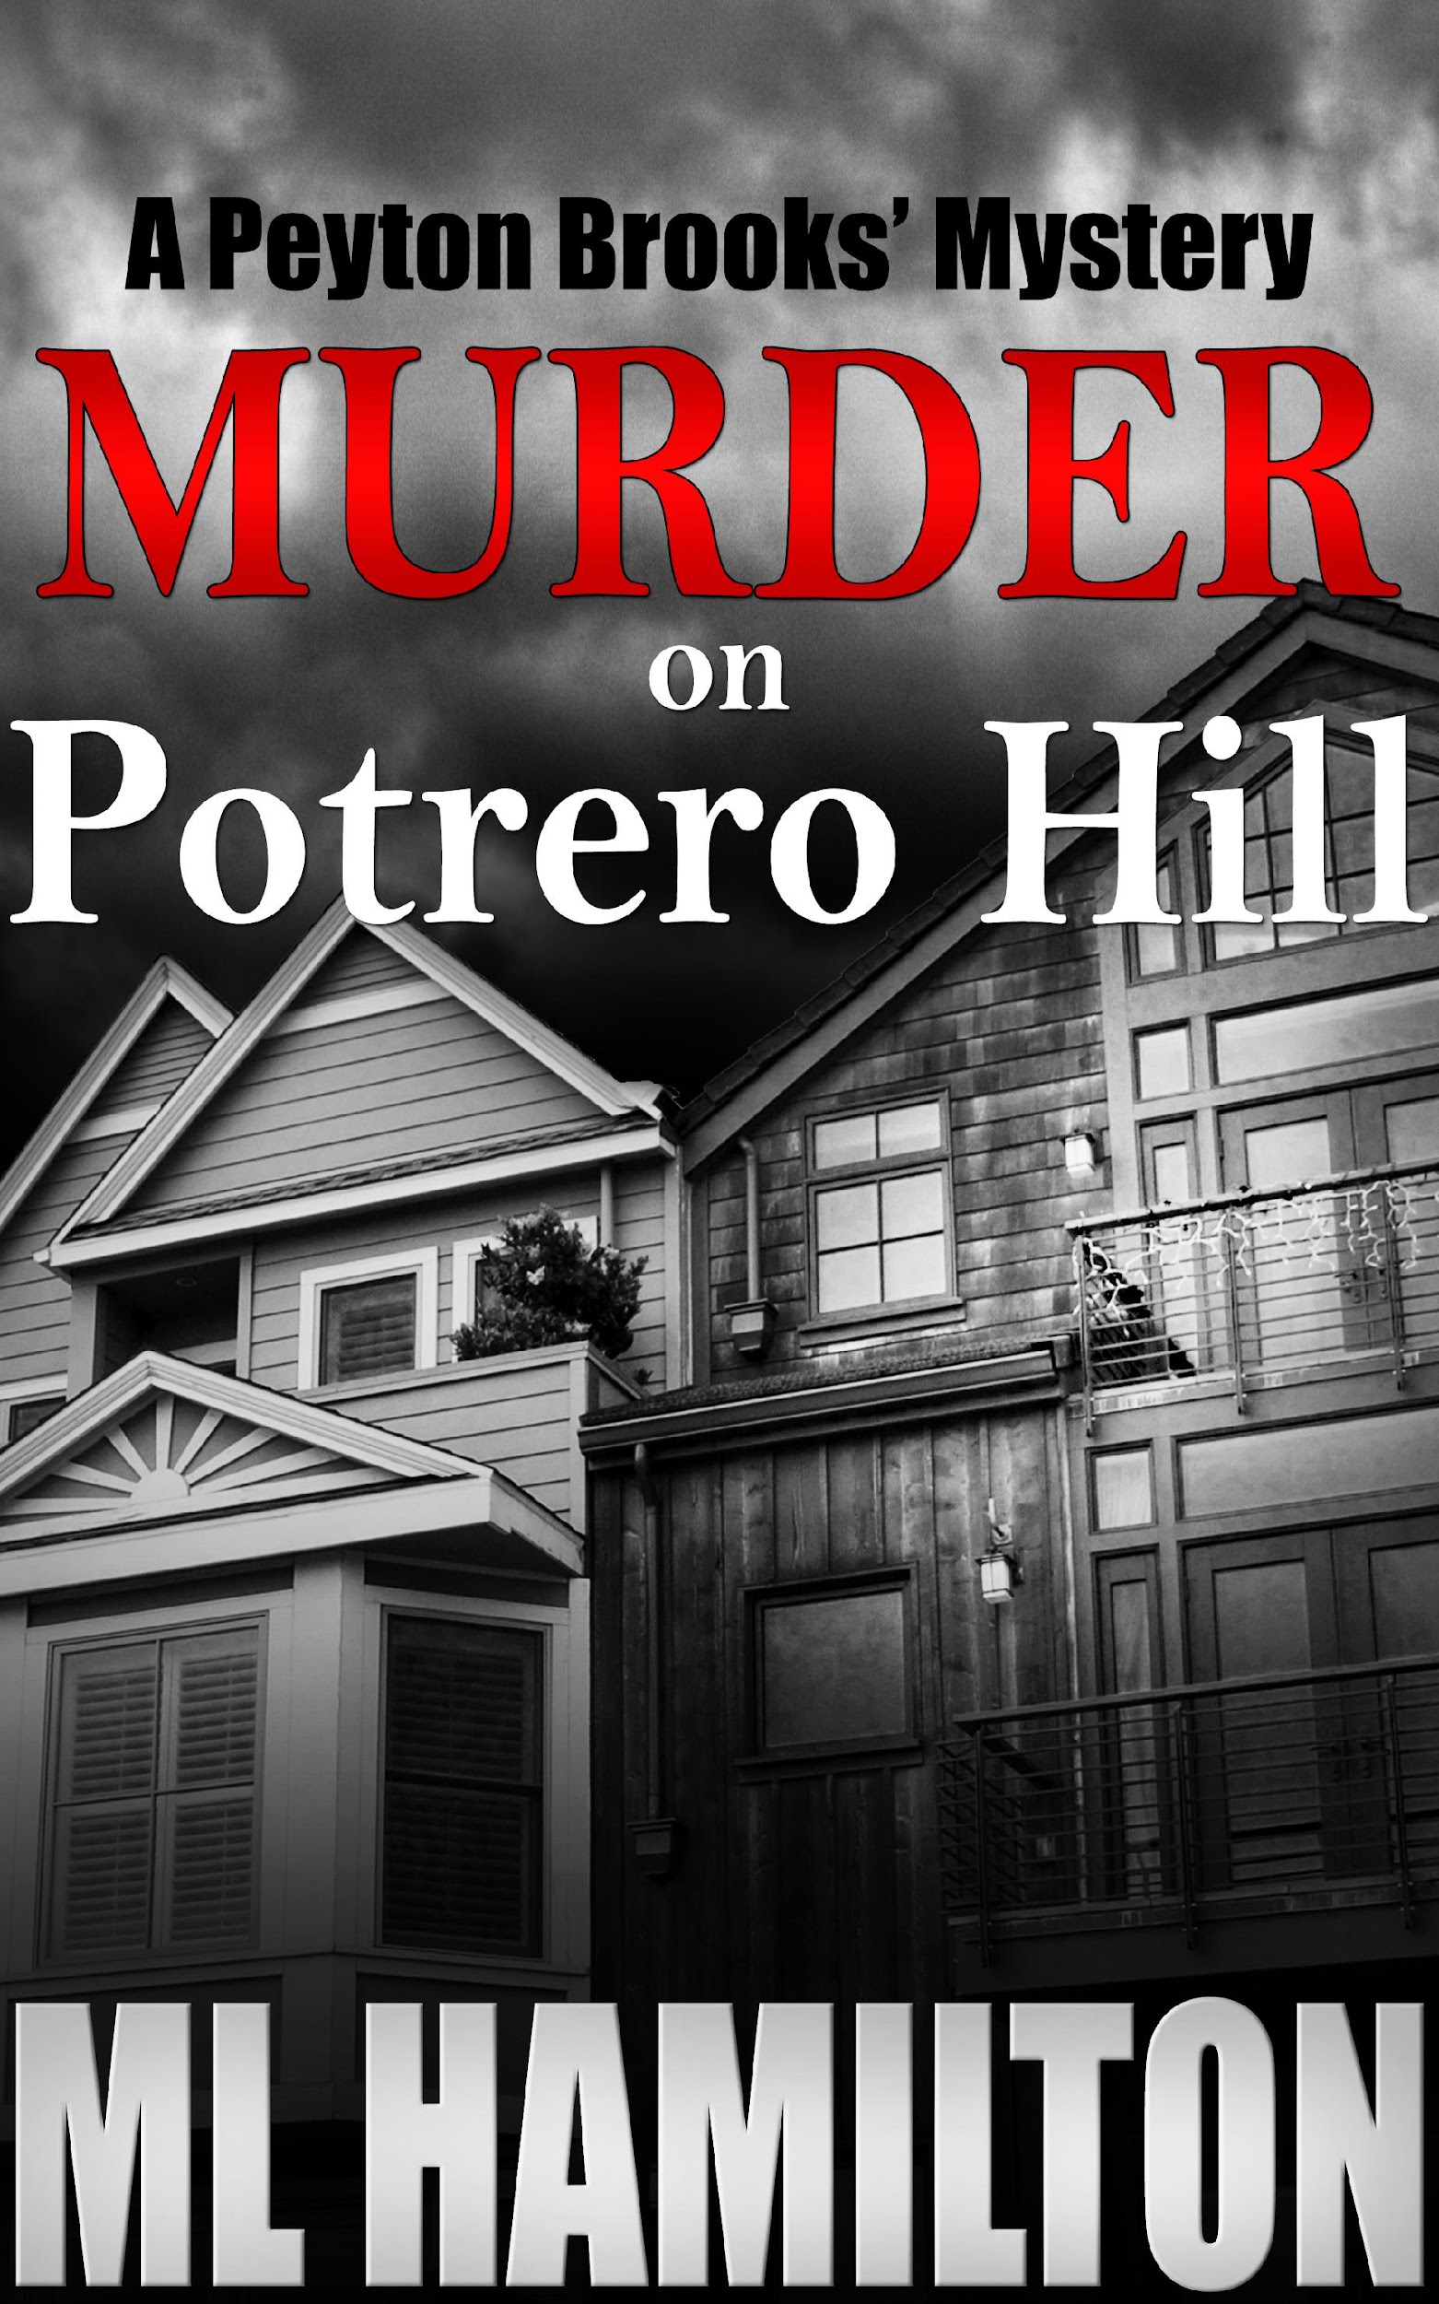
Murder Mysteries
Most popular genre (next to Romance)
Death in the Family Inspired a Story
Desire to write modern dialogue
Murder on Potrero Hill published 2013

Slide 10
Characteristics of a Murder Mystery
Mystery
Complex Plot
Murder
Crime and Criminal
RESEARCH

Slide 11
Switching Genres Benefits
Reach a new audience
Hone your skills
Avoid being a one-trick pony

Slide 12
Switching Genres Difficulty
Loss of some readers
Building a new audience
Splitting Resources
Keeping everything straight
Not writing as “fast” as your readers read

Slide 13
Suggestions for Switching Genres
Know why you want to switch.
Set a goal.
Create a book calendar or considered ending one genre and focusing on another.
Be careful about using different pen names. You built an audience with your first name. Think long and hard before you switch it.
Read, read, read in your new genre.

Slide 14
Final Thoughts
Make sure you enjoy reading the genre you’re writing in.
Join a critique group of people who write in your new genre.
Find editors who specialize in your new genre.
Be patient! Being a writer is playing the long game. Don’t expect instant results!
Five-year rule.

Slide 15
Contact Information
M.L. Hamilton
Website: www.authormlhamilton.net
Email: authormlhamilton@gmail.com
Address: P.O. Box 2556
Elk Grove, CA 95759
Questions?

