Slide 1
RESEARCH FOR WRITERS
For California Writers Club
Feb 2, 2024
Kathy Lynne Marshall
KathyLynneMarshall.com
GRAB A PENCIL & PAPER FOR RESEARCH FUN!
Notes:
Welcome everyone to this presentation entitled Research for Writers. My name is Kathy Lynne Marshall and I’m delighted to be here with you. Please save your questions for the end of the presentation.
Do you have a pencil or pen and paper, or a smartphone that you can type your responses on? Yes, you’ll get more out of this if you play along with a few fun exercises I have planned for you. But I won’t be calling on you, so don’t be scared!
I worked for the California Highway Patrol for 36 years as researcher, analyst, technical writer and human resources specialist, writing nothing but the facts, ma’am.
But after 40 years of haphazardly collecting family history documents, I finally figured out how to motivate myself to analyze the research to write family story books. One published book per year became my mandate in 2016.
But how? I grew up in California without knowing much about my ancestors in Ohio, Maryland and Georgia. It’s devilishly difficult for descendants of enslaved people to find historical information about our ancestors.

Slide 2
Sharing My Research Toolkit
Research can enhance your stories. Discuss:
Setting goals.
Locating details that make books rich in storytelling and fact.
Taking a research trip to enhance your setting and characters.
Ways to turn dry facts into engaging tales.
Notes:
Today, I’ll be sharing with you my research toolkit. Even if you’re not interested in genealogy, these measures may help all genre of writers.
Today, we’ll talk about:
Setting writing goals.
Finding factual material that lends credibility to your writing.
Locating details that make books rich in storytelling and fact.
Taking a research trip to enhance your setting and characters.
Practicing ways to turn dry facts into engaging tales.
Get pencil and paper, or smart phone ready to participate in writing exercises.
Please save your questions for the end please.

Slide 3
How Many of You ...
Have already published a book?
Are in the process of writing a book?
Enter short stories or books into award competitions?
Write for your bread and butter?
Want to sell your books?
Simply want to gift your books to family and friends?
Want to be on the New York Times best seller list?
Having a goal is important to achieving your view of success.
Notes:
First, I’d like to find out a little about you. How Many of You ...
Have already published a book?
How many are in the process of writing a book?
How many enter your short stories or books into competitions that have a monetary or other prizes?
How many are professionals who write for your bread and butter?
How many want to sell your books?
How many simply want to gift your books to family and friends?
How many yearn to be on the New York Times best seller list?
Having a goal is important to achieving your view of success. My goal is publishing at least one book per year. Think about what your goals are, to help you stay on track. Instead of me droning on and on, imagine how what I am presenting could enhance YOUR writing journey. Take a minute to list your writing goals.

Slide 4
The Desired End Result First?
ZOOM CHAT
Why think about the finished product 1st?
What genre?
What end result showcases U best?
Notes:
When I’m starting a new writing project, I like to think about the end result first. Not everyone is interested in publishing paperbacks to be sold on Amazon. It’s just too daunting for some people.
Do you have a burning desire to create a podcast, blog, photo book, documentary, or hardback book? What about a newsletter, Facebook page, or a screenplay? Write down your desired end result for your writing project.
What genre will you write: Science fiction? Nonfiction? Romance? Mystery? Poetry? While I want to be considered a competent genealogist—meaning a non-fiction writer—I want the books to be interesting to anyone over the age of ten. I gather as many facts as I can, then dabble a bit with plot development, and try to bring out my family’s characteristics. I usually write the story from my ancestor’s point of view. No, I wasn’t personally in Talbot County, Georgia, in 1856 to hear exactly what the Marshall slave owner told my ancestors to do, but I want the reader to feel and see and hear what my ancestors may have experienced.
There are many ways of communicating your words and I want to encourage you to find what floats your boat. Do you want to speak from your heart in the first person “I” did this, or the second person “You” did this, or the third-person “She” did this, or an omniscient narrator point of view? Why bother thinking about point of view and end products at the beginning of your research? Because it helps organize your writing approach.

Slide 5
Gather Research Facts
Google is your best friend, for example:
“Handcuffing techniques in 1880 England”
Read books, periodicals, newspapers, magazines dealing with the desired subject matter.
ChroniclingAmerica.loc.gov = maps & images
Do your own primary & secondary research for your genre.
Notes:
Why should I research anything? I’ve got the story in my head, ready to spill onto the paper. How many of you like to read detective stories or science fiction? How would you feel if the author obviously didn’t know the first thing about police procedure, or confused our solar system with a nebula? Would you keep reading or chuck the book because it wasn’t believable?
Google Search is our best friend. For example, in your computer browser, type “handcuffing techniques in 1880 Victorian England,” if that’s what you are writing about. Use quotes to indicate which words must absolutely be in the search results. A wealth of potential responses should appear on screen to help you determine how to approach the topic in your story. No plagiarism. Just fact finding.
Free Google Books online may help you find the perfect information.
Read other books/periodicals/newspapers/magazines dealing with the same subject matter.
Check out ChroniclingAmerica.loc.gov for images which can give you descriptive ideas for your book.
Do your own primary research, like interviewing cops and doctors, etc., about your subject matter, or travel to the location where your story takes place.

Slide 6
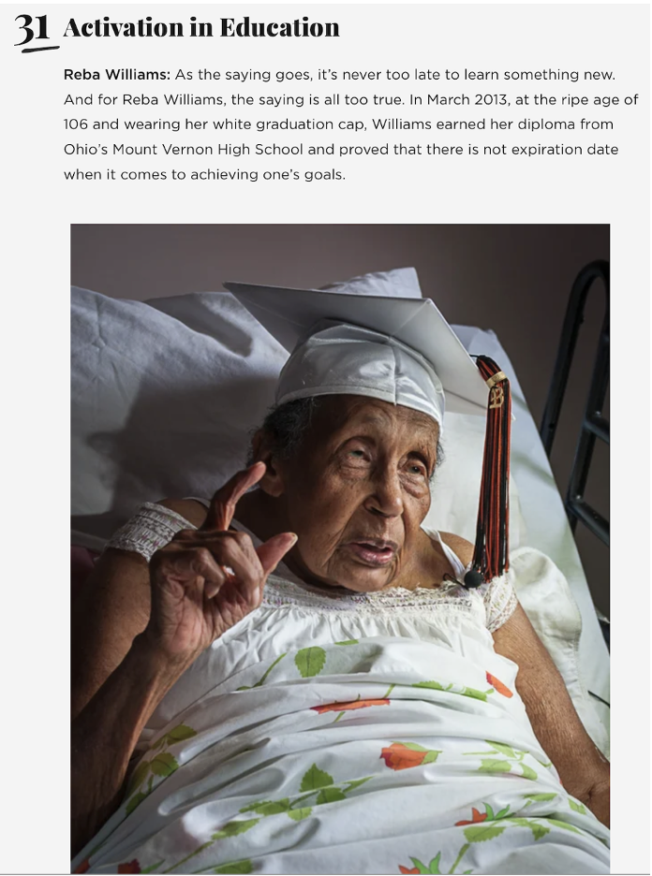
Primary Research: = Obtain First-Hand Secondary Research = Use Existing Data
Reba May Williams 1907-2014
“I don't know why everybody’s making such a big deal about me getting my high school diploma at 106 years of age. Jay Leno told my story one night on his Tonight Show, after the Associated Press broadcasted my story all over the news wires in America, and even in England.
“And can you believe that Essence Magazine put a picture of me, Reba Williams, in their December 2013 edition? See, I am sitting up in my bed in my white cap and gown. It was all too much hullabaloo! Just the same ol' same ol' to me."
Notes:
Why should I research anything? I've got the story in my head, ready to spill onto the paper. How many of you like to read detective stories, or science-fiction? How would you feel if the author obviously didn't know the first thing about police procedure, or confused our solar system with a nebula? Would you keep reading or Chuck the book because it wasn't believableHere is an example of first-hand primary and secondary research. Secondary research is what most of us do: we compile/rearrange existing data from books, online, etc., like the summary on the picture above right. Primary data would be the many times I personally interviewed my Great-aunt Reba 1983 and 2014, when she died at 107 years of age.
Her chapter in my first book, The Ancestors Are Smiling!, is the most well-documented story I’ve ever written. In addition to my interviews, there are numerous video and newspaper interviews about her 100th birthday and when she became a Superstar at 106. I found interviews from as far away as England with her actual words, so I could populate her story with citations and photographs of her life, as told by Reba herself. READ THE ABOVE
Think about the topics you write about. How do you know whether the secondary sources you find on the internet are true? Wikipedia is written by people who aren’t necessarily experts; I examine the actual sources they quote in their Wikipedia article, and I seek data from multiple sources.

Slide 7
Cite All Research Sources
Log each source.
Footnote and end note format: (per Chicago Book of Style): Footnote #. Author’s First and Last Name, Book Title: Subtitle, edition (if applicable). (Place of Publication: Publisher, Publication Date), page#.
Copy URL of sources, paste into manuscript footnote.
Fiction writers get to snub citations? Lucky!
Notes:
For nonfiction works, it is very important that you log each research source you consult, either in a footnote or end note, generally using the formats shown above. As I’m writing my manuscript, I copy the URL of the web containing the data that’s helping me frame the story. Yep, I paste the URL in a footnote in my draft.
How many of you fiction writers keep track of your research sources? Maybe you don’t have to, lucky souls, but nonfiction folks had better do it to seem more credible.

Slide 8
Organize & Consolidate the Data
w
I
L
L
I
A
M
S
Notes:
I use spreadsheets to consolidate the data I collect for each character family member I’m studying. This chart includes data from Census, marriage records, and Death certificates. You can also use this format if you are making up the dates and places for you fiction story.
The first step is to turn the facts into English sentences. Think Dragnet: nothing but the facts, ma’am.mHere’s a sample factual paragraph about my protagonist, great-great-grandfather Otho Williams in my Finding Otho: The Search for Our Enclosed Williams Ancestors.
Otho was born in 1834 in Frederick, Maryland. He married Alice. Otho was a farmer at some point in his life. He died in Boonsboro, Maryland, in 1889. Boring? Yes, but it’s the first step.
The next step is to enhance the facts with description, setting, and dialog. Later, I’ll give you three writing prompts to help practice these techniques.

Slide 9
Locate Details that Enrich Your Story
Review
Review your research questions and pick out facts that will answer the WHO, WHY, WHEN, WHERE, HOW and WHAT questions.
Dates
Dates: research the time period and include the information in a timeline, perhaps sorted by event date.
Places
Places: research the time and place.
Names
Names: determine how the people are connected to each other.
Occupations
Occupations: research duties for that time period (e.g., teacher, nurse, maid, factory worker, farmer, laborer, judge).
Incidents
Incidents: (e.g., jail sentence [court records], marriage [newspaper], reason for death [Death certificate, cemetery records], graduation [online yearbooks]).
More
Research
More: research period clothing, housing, food, hobbies, setting, etc.
Notes:
Review your research questions and plot twists and examine the documents for facts that will answer the WHO, WHY, WHEN, WHERE, HOW, and WHAT questions we writers should cover.
Dates: research the time period and include info in a timeline.
Places: research the time and place where the action occurred.
Names: determine how characters connected to each other.
Occupations: research those occupational duties for the time period (e.g., teacher subjects, classroom descriptive; nurse technology, normal duties, uniform and setting; maid duties; factory worker sounds, smells and duties; farmer, tools and seeds; judges, etc.).
Incidents: research further (e.g., look up fingerprinting and other steps for jail sentencing examples, court records for similar crimes you want to write about; reasons for death found in Death certificates, medical assessments, cemetery records, etc.
More categories: research period clothing, what types of foods eaten, hobbies, furnishings, the setting, etc.

Slide 10
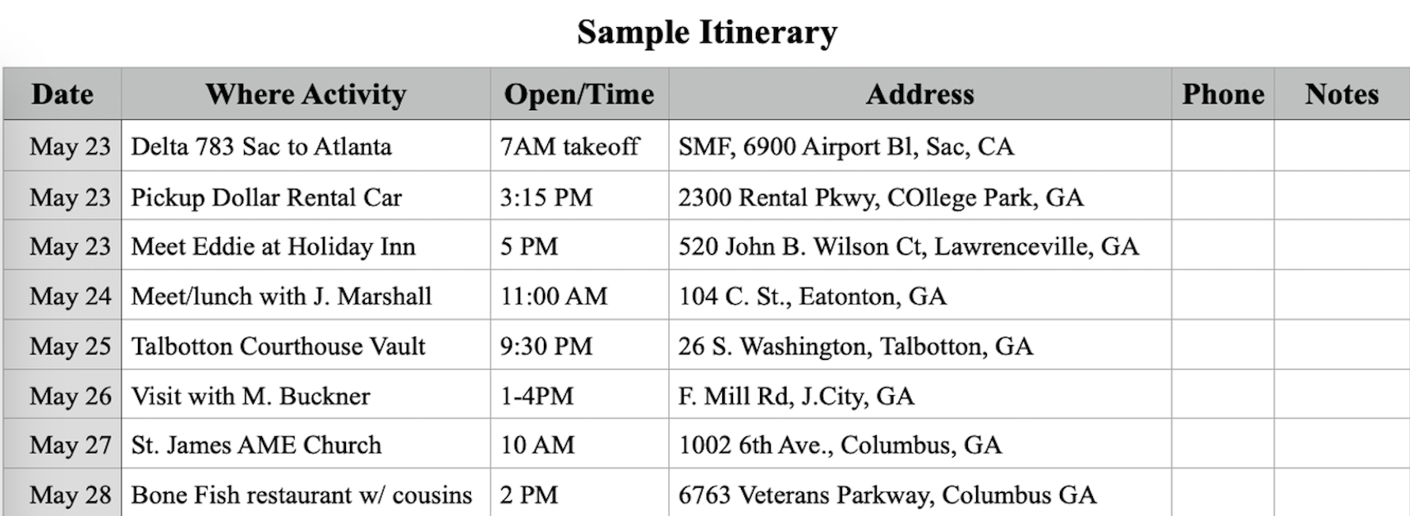
A Research Trip Can Enhance Your Setting & Characters
Sights, Sounds, Smells, Touch. Take pictures and video. Write a daily diary.
Peruse local historical records unavailable online, e.g., land deeds, newspapers, courthouse records.
Create an itinerary.
Notes:
A Research Trip Can Enhance Your Setting & Characters
It’s easier to write about the Sights, Sounds, Smells, Touch if you actually experience those sensations.
Don’t forget to take lots of pictures and video and write a daily diary of your impressions and emotions during your research trip
Peruse local records at the courthouse and public libraries that are unavailable online, e.g., newspapers, courthouse records, vital records, land deeds.
Create an itinerary like the one shown to get the most out of your trip. Don’t spend thousands of dollars on airfare, car, rental, and hotel, only to arrive at the courthouse without knowing exactly what you want to research. Figure all that out before you leave your house to make your trip worth the money.

Slide 11
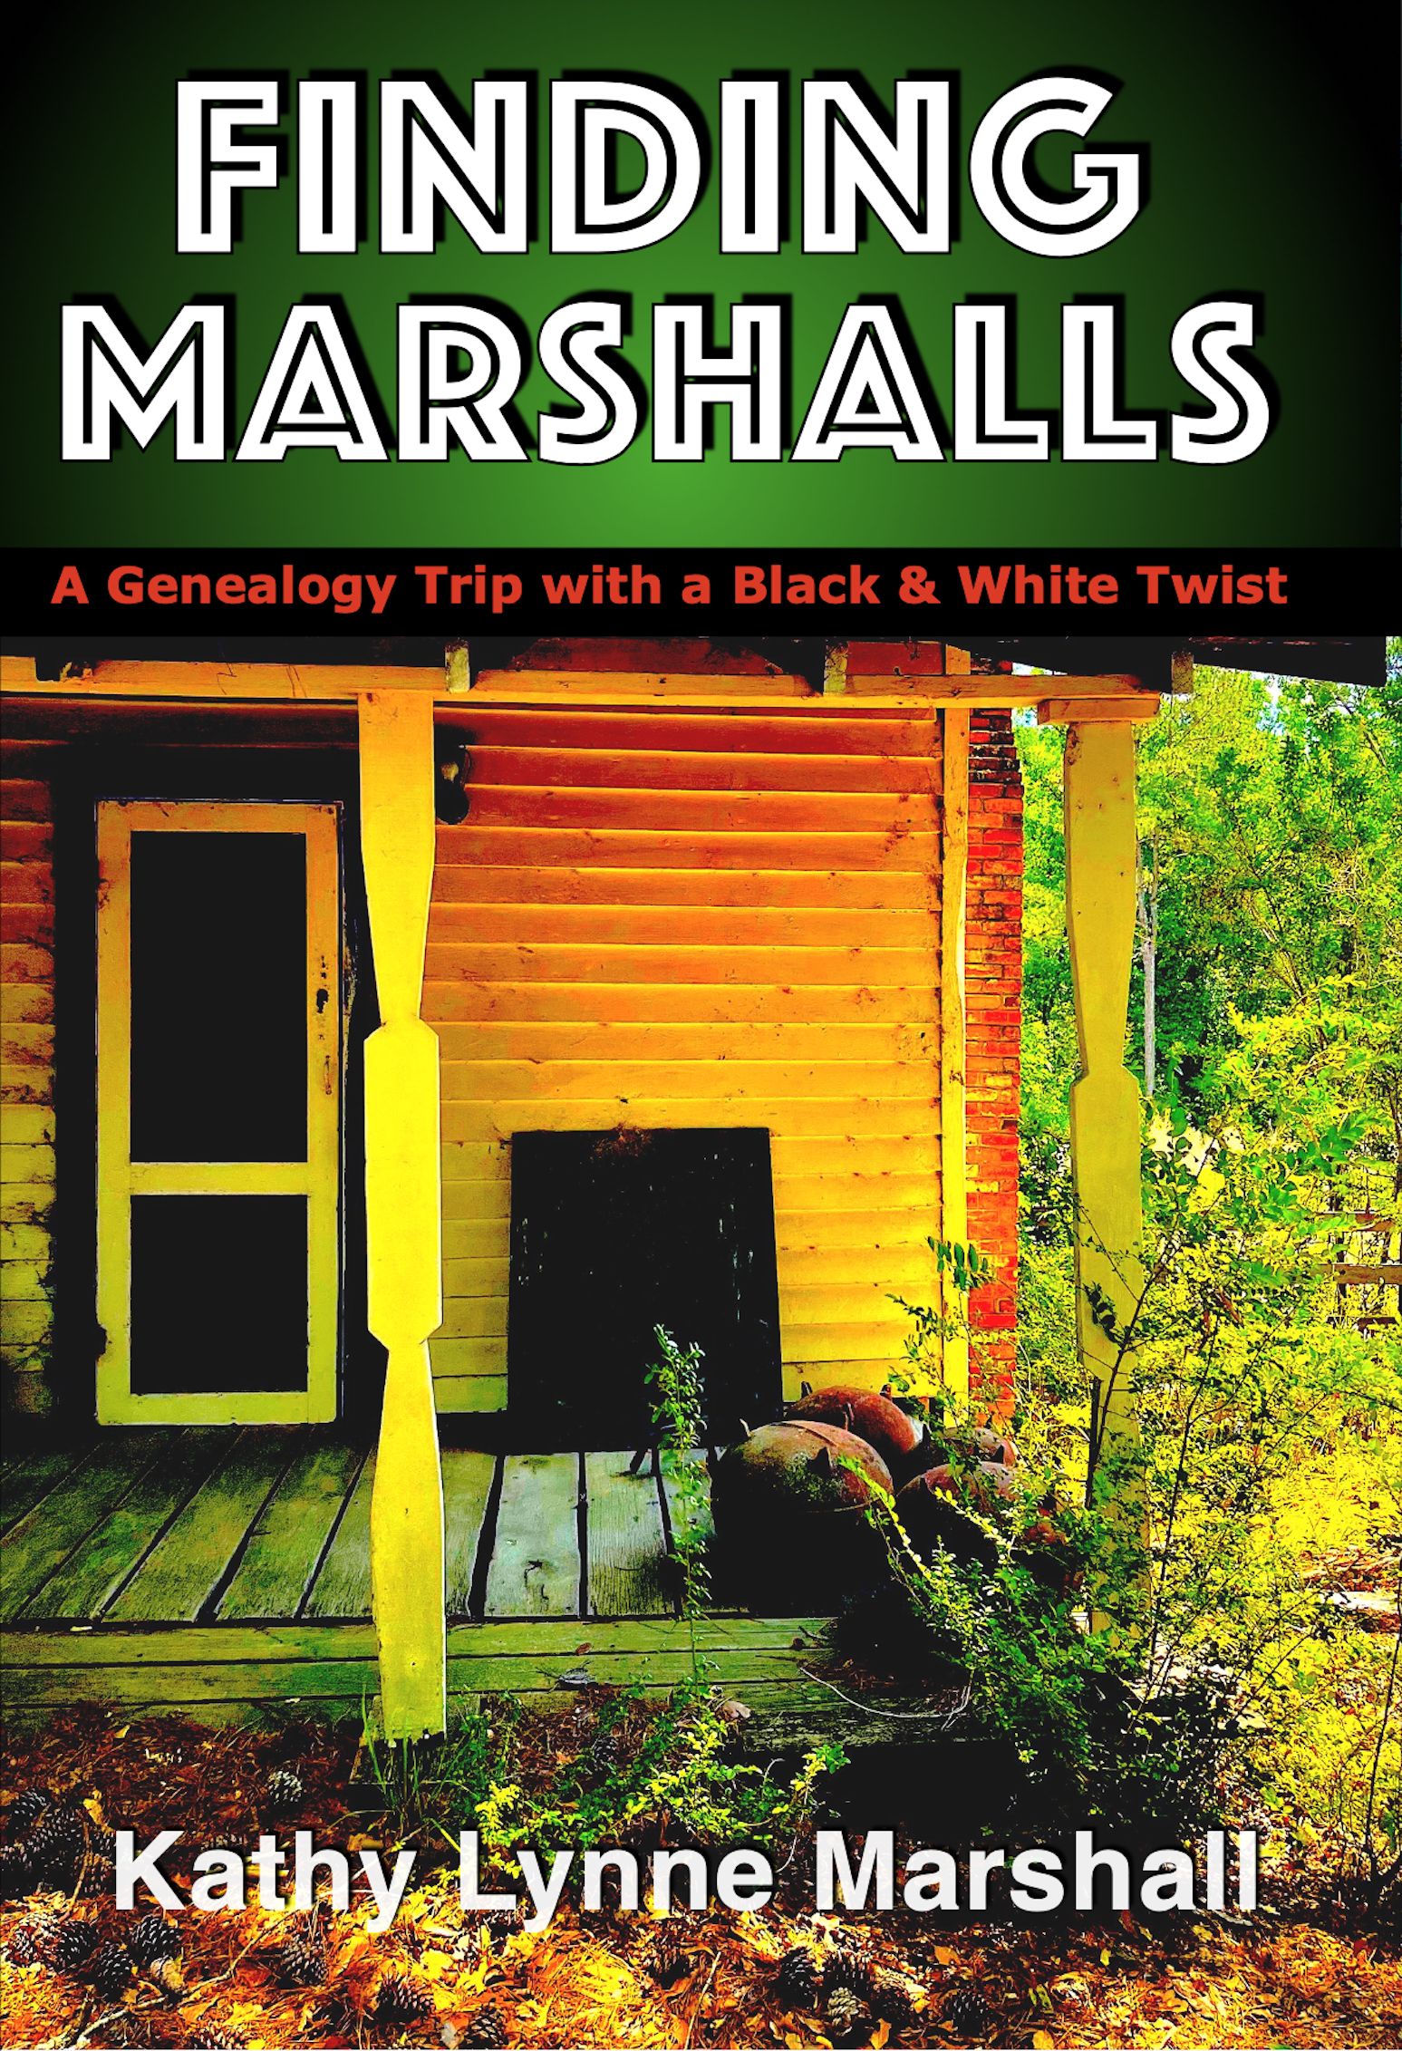
Traveling Through Georgia in 2021 with a White Cousin
I needed a moment to assess the lavish foyer with its navy-blue and taupe patterned rug, under a hefty four-foot square table. A handsome flower arrangement of coleus, ferns, and ivy topped the table. Four columns separated the foyer from the staircase and first-floor hallway. Despite its age, the venerable old house didn’t smell musty. The walls seem to whisper their secrets:
That’s the hallway where Master fondled Sally’s behind. Young Master spit on Yellow Bob from the top of those stairs. Mistress slapped Susie for taking too long bringing her sweet tea. Every day, it was humiliation after humiliation.
Notes:
Here’s an excerpt from my Finding Marshalls family heritage book to give you an idea of what I experienced in Georgia in 2021 while traveling with a white cousin. READ THE ABOVE.
.
Traveling to the Deep South where my paternal Marshall family was enslaved was so visceral. Imagining my ancestors working in the hot sun, retreating at night to sub-par shacks, forced to eat the worst parts of animals, regularly being sexually violated by the white master to produce mulattos who look like me, etc. And the freeing conversations my white cousin and I had in the car and our shared hotel room. In the “Car Talk” chapter we revealed our feelings about our common slave-owning Marshall family, current race relations, and religion. Many Americans feel it’s taboo for Blacks and Whites to exchange those ideas, but Cousin Amy and I felt it was pure magic!
I had not originally planned to write a paperback about this trip. I usually just write a photo book of my adventures. But this trip was so emotional, so revealing, so ultimately positive that I couldn’t resist sharing the results of our collaboration. This is the epitome of how beneficial a research trip can be in helping to bring the story alive.

Slide 12
How I Bring Facts to Life
I read so much that I imagine being in my ancestor’s presence.
Write from the ancestor’s point of view.
Use a storyteller or other third party to tell the stories.
Use dialogue to engage characters.
Truth talk: I need to do a better job visualizing my ancestors so I can describe them better.
Notes:
How I bring facts to life. First, full disclosure. I find very few documents about my enslaved ancestors to prove my lineage, at least not to the satisfaction of the daughters of the American Revolution. Plain and simple. Enslaved people in America were thought of as property, like a cow or a plow, and they are rarely mentioned by their names in the usual genealogical documents. I’m forced to read other sources to find information that may apply to my family.
So, how do I bring facts to life? I totally immerse myself so much that I dream about my ancestors and awake with what I imagine their words would be. Don’t you sometimes feel your protagonist is revealing their story to you?
I mostly write my books from my protagonist ancestors’ point of view. Sometimes I use a storyteller to tell the slavery era stories prior to 1865. And, yes, I depart a bit from pure nonfiction by using dialogue to engage the reader with my characters.

Slide 13
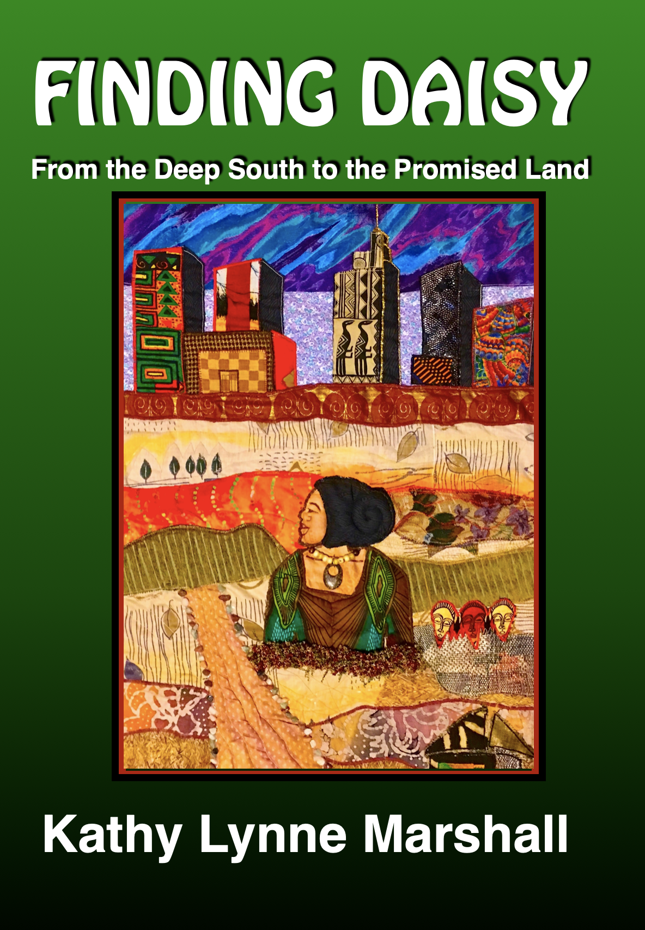
Newspapers Bring Grandma to Life
70 news articles telling:
Where she was
Why she was there
What she wore
What she was doing
Who she was with
What she valued
Exactly what she said.
Kathy made a quilt about Daisy’s life for the cover
Notes:
The Cleveland “Call and Post” newspaper recorded 70 news articles about my Grandma Daisy.
I learned where she was, why she was there, what she wore, what she was doing, who she was with, what causes she valued, what she ate, and exactly what she said.
Grandma reportedly said, “In September 1947, I was photographed by the esteemed Allen E. Cole at his studio at 9904 Cedar Avenue. He was the most famous and prolific photographer in Cleveland, with 22 years of experience in photographing prominent people. I was honored that he promoted my credentials on one of his newspaper advertisements: ‘Mrs. Daisy Marshall, a licensed embalmer & undertaker.’ That’s precisely how we colored folk helped each other grow our businesses in the city, raising up our Negro community as a whole.

Slide 14
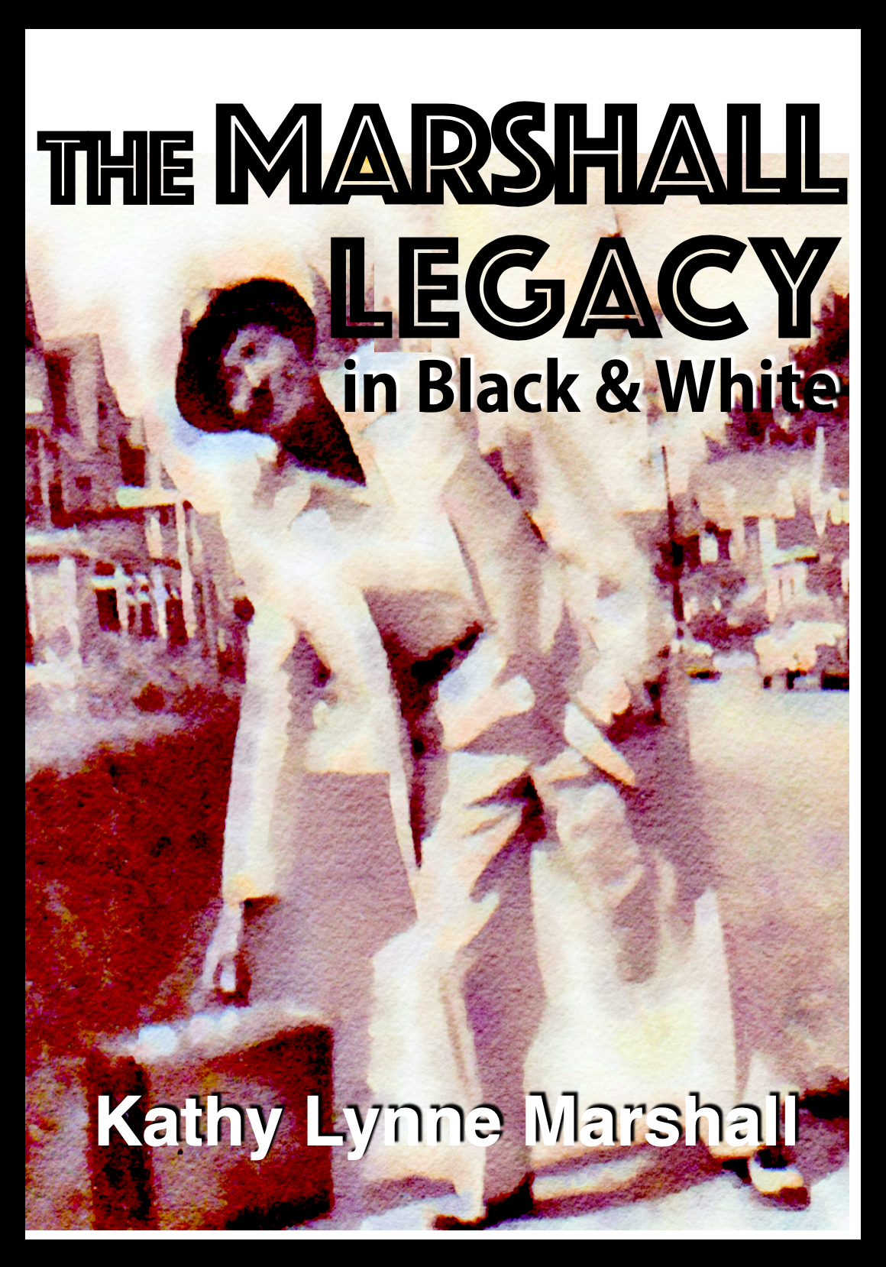
2XGGF Israel Smith Told the Tale in a Congressional Record!!!
“The trouble happened one Saturday in June 1870 with Negroes voting for the first time.
Conservatives promised money in return for Black votes. Guns waving in the air, people cursing in church. The Devil entered those God-fearing folk, encouraging them to blaspheme inside the House of the Lord.
I, your PawPaw, had to stop the desecration, and I mean right now!”
Notes:
I never would have guessed that my paternal Great-great-grandfather, Reverend Israel Smith, was interviewed by a Congressional Committee in 1870. Believe it or not, 123 years ago, the Ku Klux Klan and other White nationalist groups exerted extreme violence to prohibit newly-freed Blacks from voting in the 1870 election in Alabama. The inquiry resulted in a voter recount changed the outcome toward the more liberal candidate.
Rev. Smith’s narrative named the people involved, dates, places, outcomes, etc., which allowed me to write a “spirited” chapter in The Marshall Legacy in Black and White book. Here’s an excerpt I imagine Rev. Smith could have told his descendants one hauntingly early morning in 1928 in Columbus, Georgia.
Congressional Record Investigation Told All: The main trouble happened one Saturday night in early June, a few months before the 1870 election. At first, the Saturday night meeting of the Central Club of Macon County was proceeding normally until one man started yelling and threatening other attendees. He wanted Negroes to vote Republican [the liberal party of Lincoln at that time]. However, some were planning to vote for the [conservative] Democrats who promised members liquor or money in return for their vote. The conversation turned into a riot. Guns waving in the air, people cursing, and loud threats of bodily violence filling the sanctuary to bursting.
Just picture that lovely church. Bibles and songbooks sat in shelves behind carefully polished wooden pews, normally penitent people warming the benches. But the devil had entered those same God-fearing folk, encouraging them to blaspheme inside the House of the Lord. That’s not supposed to happen. I, your PawPaw, had to stop the desecration, and I mean right now!” I could write Israel’s story using facts, plus my description and dialog. So cool!

Slide 15
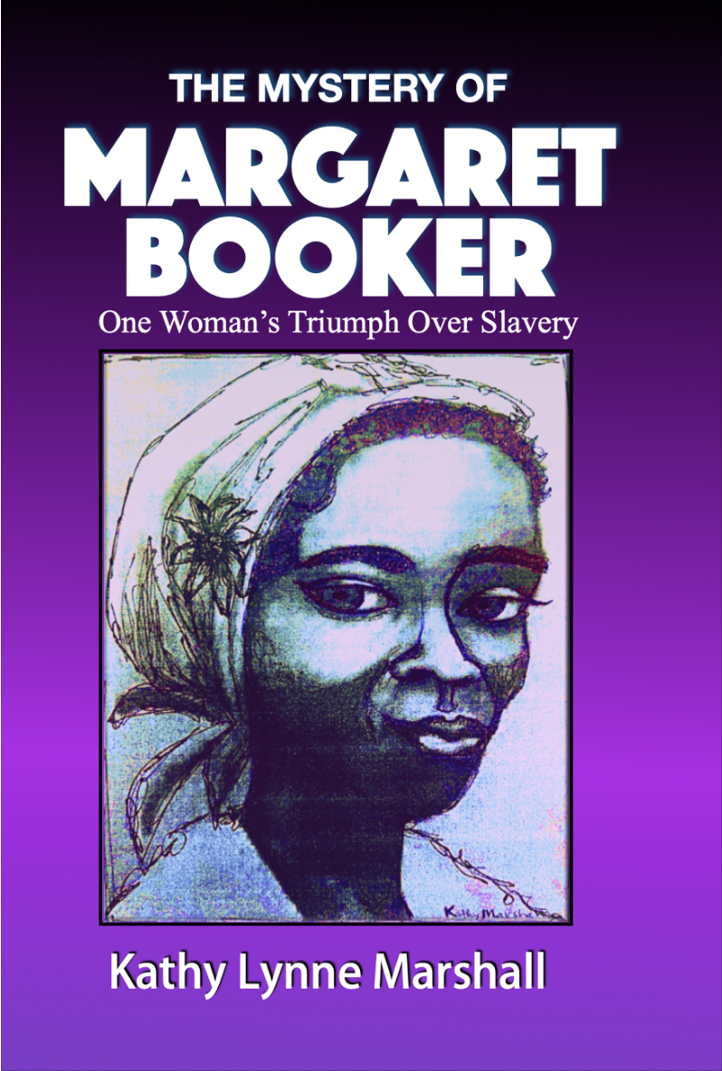
Research for Historical Family Stories
Do primary & secondary research.
Read stories from authors who write about the same location and time-period.
Enslaved 3XGGM Margaret Booker, 1834-1910.
Mary Genevieve Ward: Civil War Legends of Rich Mountain and Beverly, WV.
Beware of copyright infringement!
Notes:
Research for my historical family stories includes primary and secondary research. Reading books from other sources helps me imagine possible ways to frame my manuscript. Mary Genevieve Ward was a local schoolteacher who lived where my great-great-great-grandmother, Margaret Booker, was enslaved from 1834 to 1863. In the 1930s, Ward interviewed people who had lived in Beverly during or after the Civil War, and she wrote about their memories. I hoped to find stories that included my ancestors, or other Black folk, to learn what their lives were like during the Civil War. Here’s part of Ward’s story from my Margaret’s point of view. I imagined in the book that Margaret is telling this story to her descendants during the summer of 1910 in Barnesville, Ohio, one year before she died.
=====
My friend, Kezziah, told me a funny story. When her master, Mr. Crawford, heard the Yankees was planning to invade our town of Beverly. He hitched Griz, his old gray horse, to their biggest wagon. After seating his family in the front end of the wagon, he placed all their clothes, food, and my friend in the rear. Everything went along nicely until ten miles down the road. In Huttonsville, he was told, “You guys gotta go quickly. The Yankees are right on your heels, riding as fast as they can. “ Hearing that, Ol’ Mr. Crawford began a’runnin’ that horse at such a high rate of speed that by the time they reached the town of Mingo 20 miles south, every stitch of clothing and every bite of food had bounced outta the wagon. Nothing remained, except for Kezziah, who was lying flat on the wagon bed, holding onto its sides for dear life. From Civil War Legends of Rick=h Mountain, Beverly, Randolph County, West Virginia.
=====
Even though this wasn’t about my family, it gave me a linguistic idea of how they spoke in Beverly, and more names to research: Kezziah and Mr. Crawford who ran a general store, allowing me to write my story more authentically 160 years later.
Beware of copyright infringement, though. I slightly changed Ward’s story and POV and credited her book in the citations: From Civil War Legends of Rich Mountain and Beverly, West Virginia, Mary Genevieve Ward, McClain Printing Company, Parsons, WV, 2004.

Slide 16
WRITING PROMPT #1
Prompt #1:
Grey Zane 60 Alabaster Gray Gray 6’6” Dentist Horseman, rugged,
Old West, writer
Notes:
This is how I start my creative writing process. We’re going to take dry facts and turn them into an English sentences.
Step #1 is to write a sentence or two that contains all the listed facts for one person you chose from this character data and traits chart which identifies the last and first name; age; skin, eyes, and hair color; height; occupation; and miscellaneous traits.
For example, in the yellow highlighted sentence at the bottom, I might say 6-foot 6-inch tall Zane Grey was a 60-year-old dentist by day. His bland, alabaster skin and gray hair and eyes belied his true passion: writing about rugged horsemen living in the Old West.
Choose one of the top four people on this list. Take three minutes to write about him or her. Include all the facts listed for that one person. Don’t add any other descriptions, just the shown facts.

Slide 17
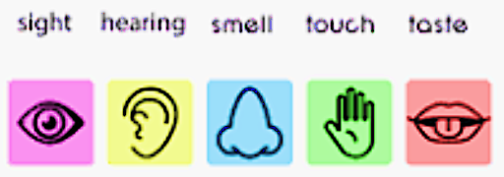
Prompt #2: Add 3-5 Sensory Flavors
Notes:
Was it easy to turn dry facts into a paragraph?
Prompt #2: Add Descriptive FLAVOR
Now, we’re going to rewrite our dry factoid paragraph from #1, adding at least three of the five senses: sight, hearing, smell, touch, and taste.
Here’s my example: Dr. Zane Grey was a 60-year-old dentist by day, his ears buzzing from the constant whir of his cold dental instruments, the smell of tooth decay a palate for his artistry. His delicate alabaster skin looked parched, but his sultry grin belied his true passion: writing another tasty episode about Dennis Q, the rugged horse wrangler galloping through a rocky range in the Old West.
Did you find the second step easy to write? Does anyone want to read their sensory paragraph?

Slide 18
Prompt #3: Add Dialog
I said
I often take the factoid paragraph and pretend I’m the protagonist talking with another character.
Add a bit of dialog to your chosen subject in prompt #2.
Do you think these writing prompt exercises will help you turn facts into fabulous?
She said
Notes:
Do you see how easy it is to reword facts into something more interesting? This helps get around potential pesky copyright issues.
Here’s Prompt #3. I often take the factoid paragraph enhanced with sensory elements, then pretend I’m the protagonist talking with another character. So go ahead and take three minutes to add a bit of dialog to your chosen subject in prompt #2.
Example: Dr. Zane Grey leaned down, tickling his patient’s quivering ear with a whisper, “Do you want to know my true passion?” Perspiration beaded on Sally’s forehead and her blood raced. “YESSS!” She sputtered, a bit of saliva spraying out of her gaping mouth. He said, “When I get home, I like to change into something more...”
“Yes, yes!” Sally moaned, as though she was having her own internal party, like the café scene in When Harry Met Sally. Oblivious to his patient’s amorous responses, Dr. Grey began chattering about his alter ego, Dennis Q, the rugged horse wrangler, wishing he was galloping on a rocky range in the Old West. Sally deflated like a popped balloon.
Do you think these writing prompt exercises will help you turn facts into fabulous?

Slide 19
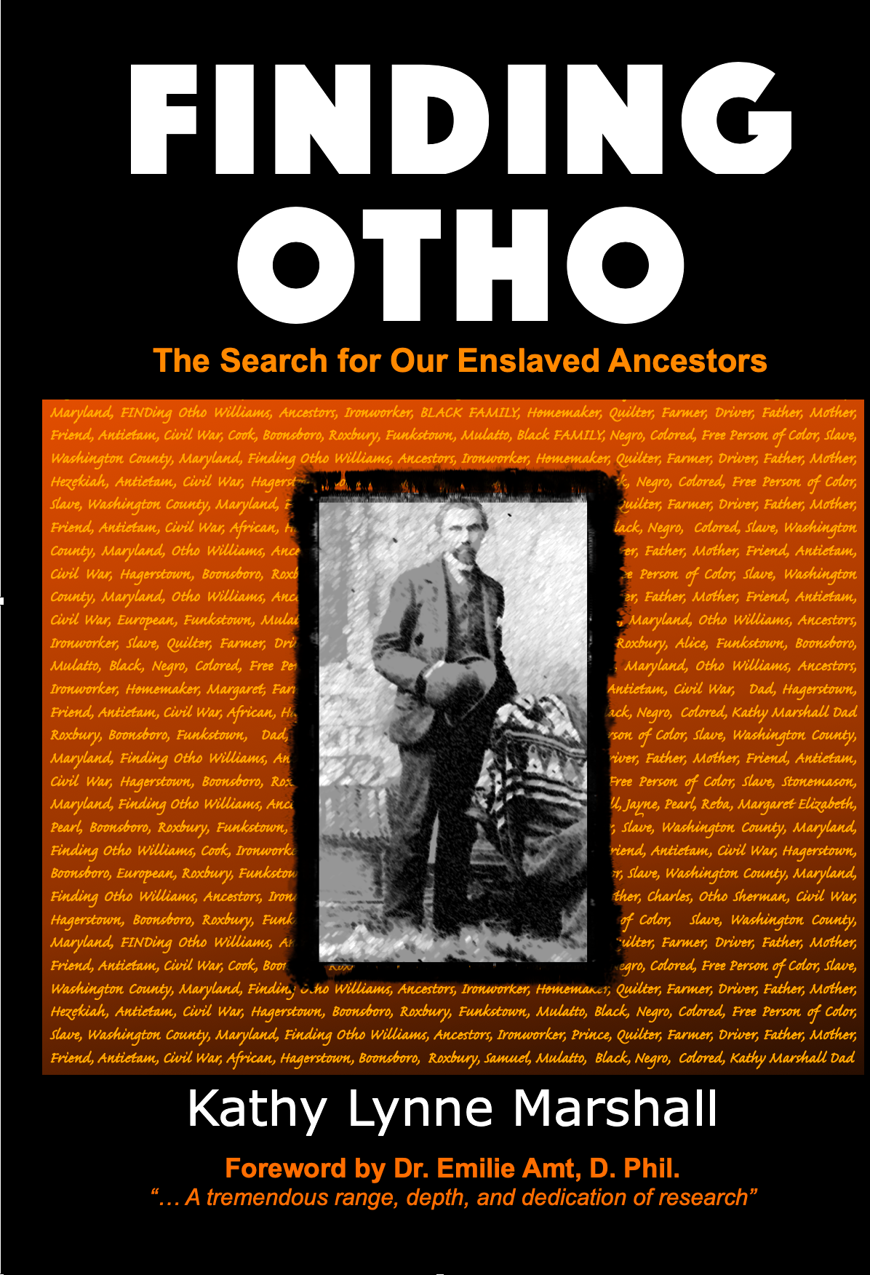
Just Get Started ... NOW!
Set goals for your writing.
Do primary and secondary research to enhance your creative storylines.
Locate details that make books rich in storytelling and fact.
Take a research trip to enhance your setting and characters.
Turn dry facts into engaging tales, using excerpts from these books as examples.
SPEAK THEIR NAMES!
Notes:
To recap: Just Get Started ... NOW!
Set goals for your writing.
Do primary and secondary research to enhance your creative storylines.
Locate details that make books rich in storytelling and fact.
Take a research trip to enhance your setting and characters.
Turn dry facts into engaging tales, using excerpts from books like mine as examples.
SPEAK THEIR NAMES! Tell their stories!

Slide 20
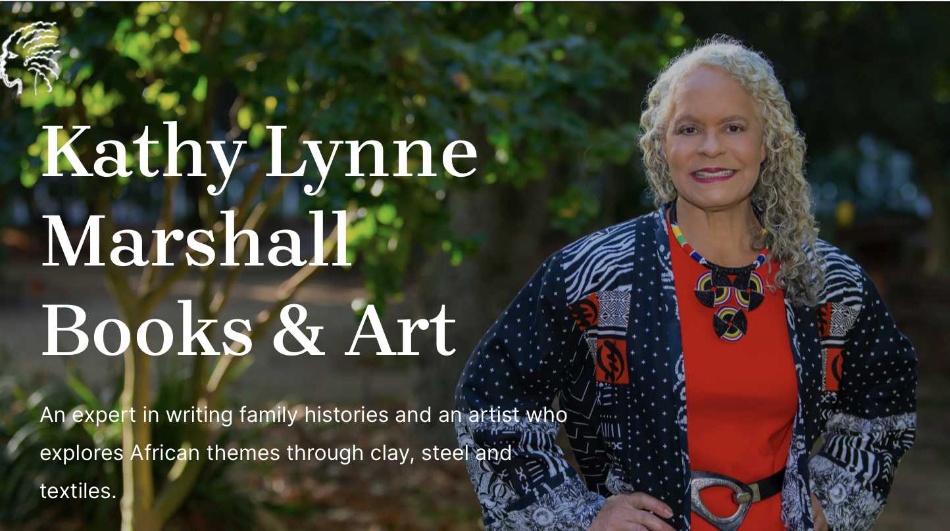
Do You Know Someone Who Could Benefit from My Information?
Know a friend or family member who is ready to turn family lore and facts from research documents into a written legacy book? Send them my way. My eight books have a special appendix that helps them research, organize, write, and self-publish their own books.
Find my books online and at KathyLynneMarshall.com
Notes:
Do you know a friend or relative who is ready to turn family lore and facts from research documents into a book? Send them my way. Each of my eight books has a special appendix called “Solving Your Mystery” which helps people learn how to research, organize, write, create a cover, get an editor, and self-publish their own books.
Check out most of my books from the usual online outlets, or all for from KathyLynneMarshall.com website, if you’d like an autographed copy.

Slide 21
Do You Have Any Questions?
Notes:
Now you can take the driest of facts and turn them into something memorable.
Thank you so much for having me today.
Do you have any questions?

